Slide 1
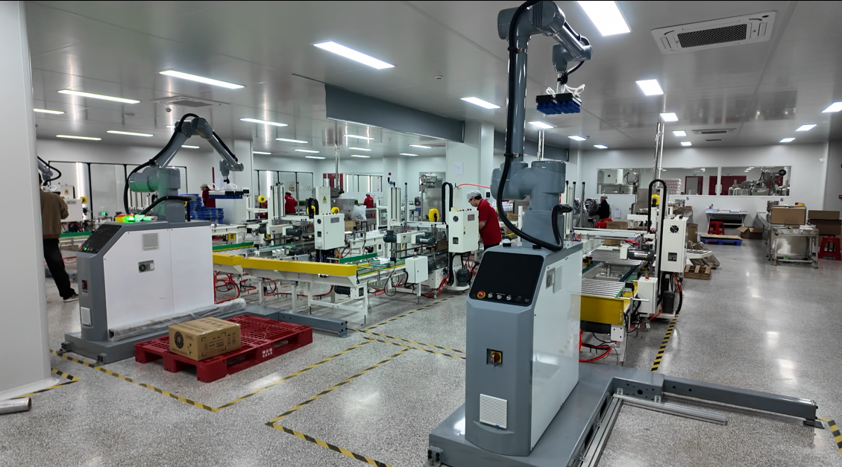
QYONZ
DOWNLOAD COMPANY PROFILE
OEM / ODM BEAUTY MANUFACTURING PARTNER IN GUANGZHOU
HAIRCARE · SKINCARE · HAIR COLOR · FRAGRANCE · BODY CARE
QYONZ combines formula development, packaging coordination, production execution and market-facing documentation support for private label and contract manufacturing projects.
LOW MOQ
OEM / ODM
FACTORY DIRECT
FAST SAMPLING
SUPPLY CHAIN
DOC SUPPORT
GUANGZHOU HUASHENG CROSS-BORDER E-COMMERCE CO., LTD.
Notes:
[Sources] /mnt/data/灌装区1.jpg

Slide 2
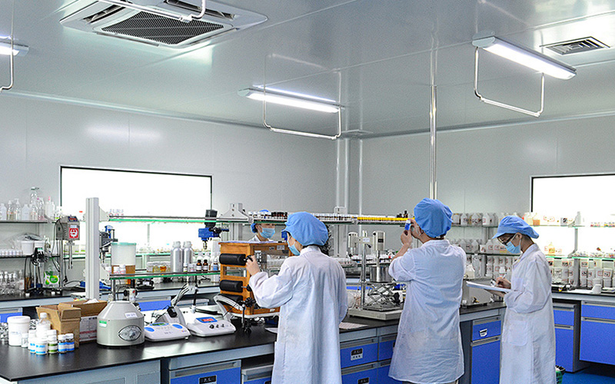

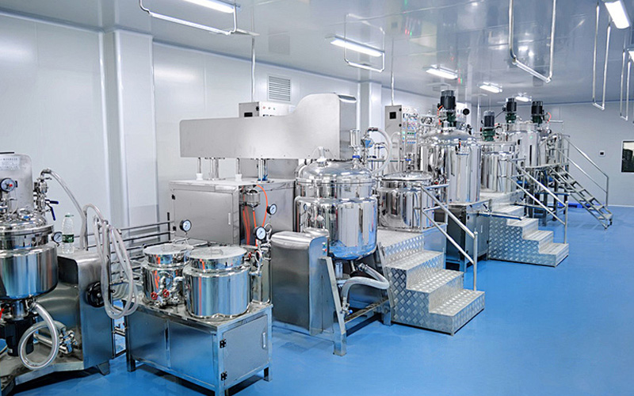
QYONZ
COMPANY OVERVIEW
A website-ready introduction for international OEM / ODM clients
QYONZ is positioned as a one-stop OEM / ODM manufacturing partner with a strong focus on factory execution, packaging coordination, supply chain support and documentation matching for global markets.
12,000 SQM
120+
6+
500–3,000 PCS
FACTORY AREA
TEAM MEMBERS
R&D STAFF
FLEXIBLE MOQ
WHAT QYONZ IS BUILT TO SUPPORT
• Private label and contract manufacturing projects for beauty and personal care brands.
• Fast sampling, formula adjustment and packaging coordination under one workflow.
• Factory-led execution suitable for brand launches, channel projects and market testing.
• Documentation support aligned with product category, target market and project scope.
2
Notes:
[Sources] /mnt/data/实验室5.jpg /mnt/data/质检2.jpg /mnt/data/灌装区5.jpg

Slide 3
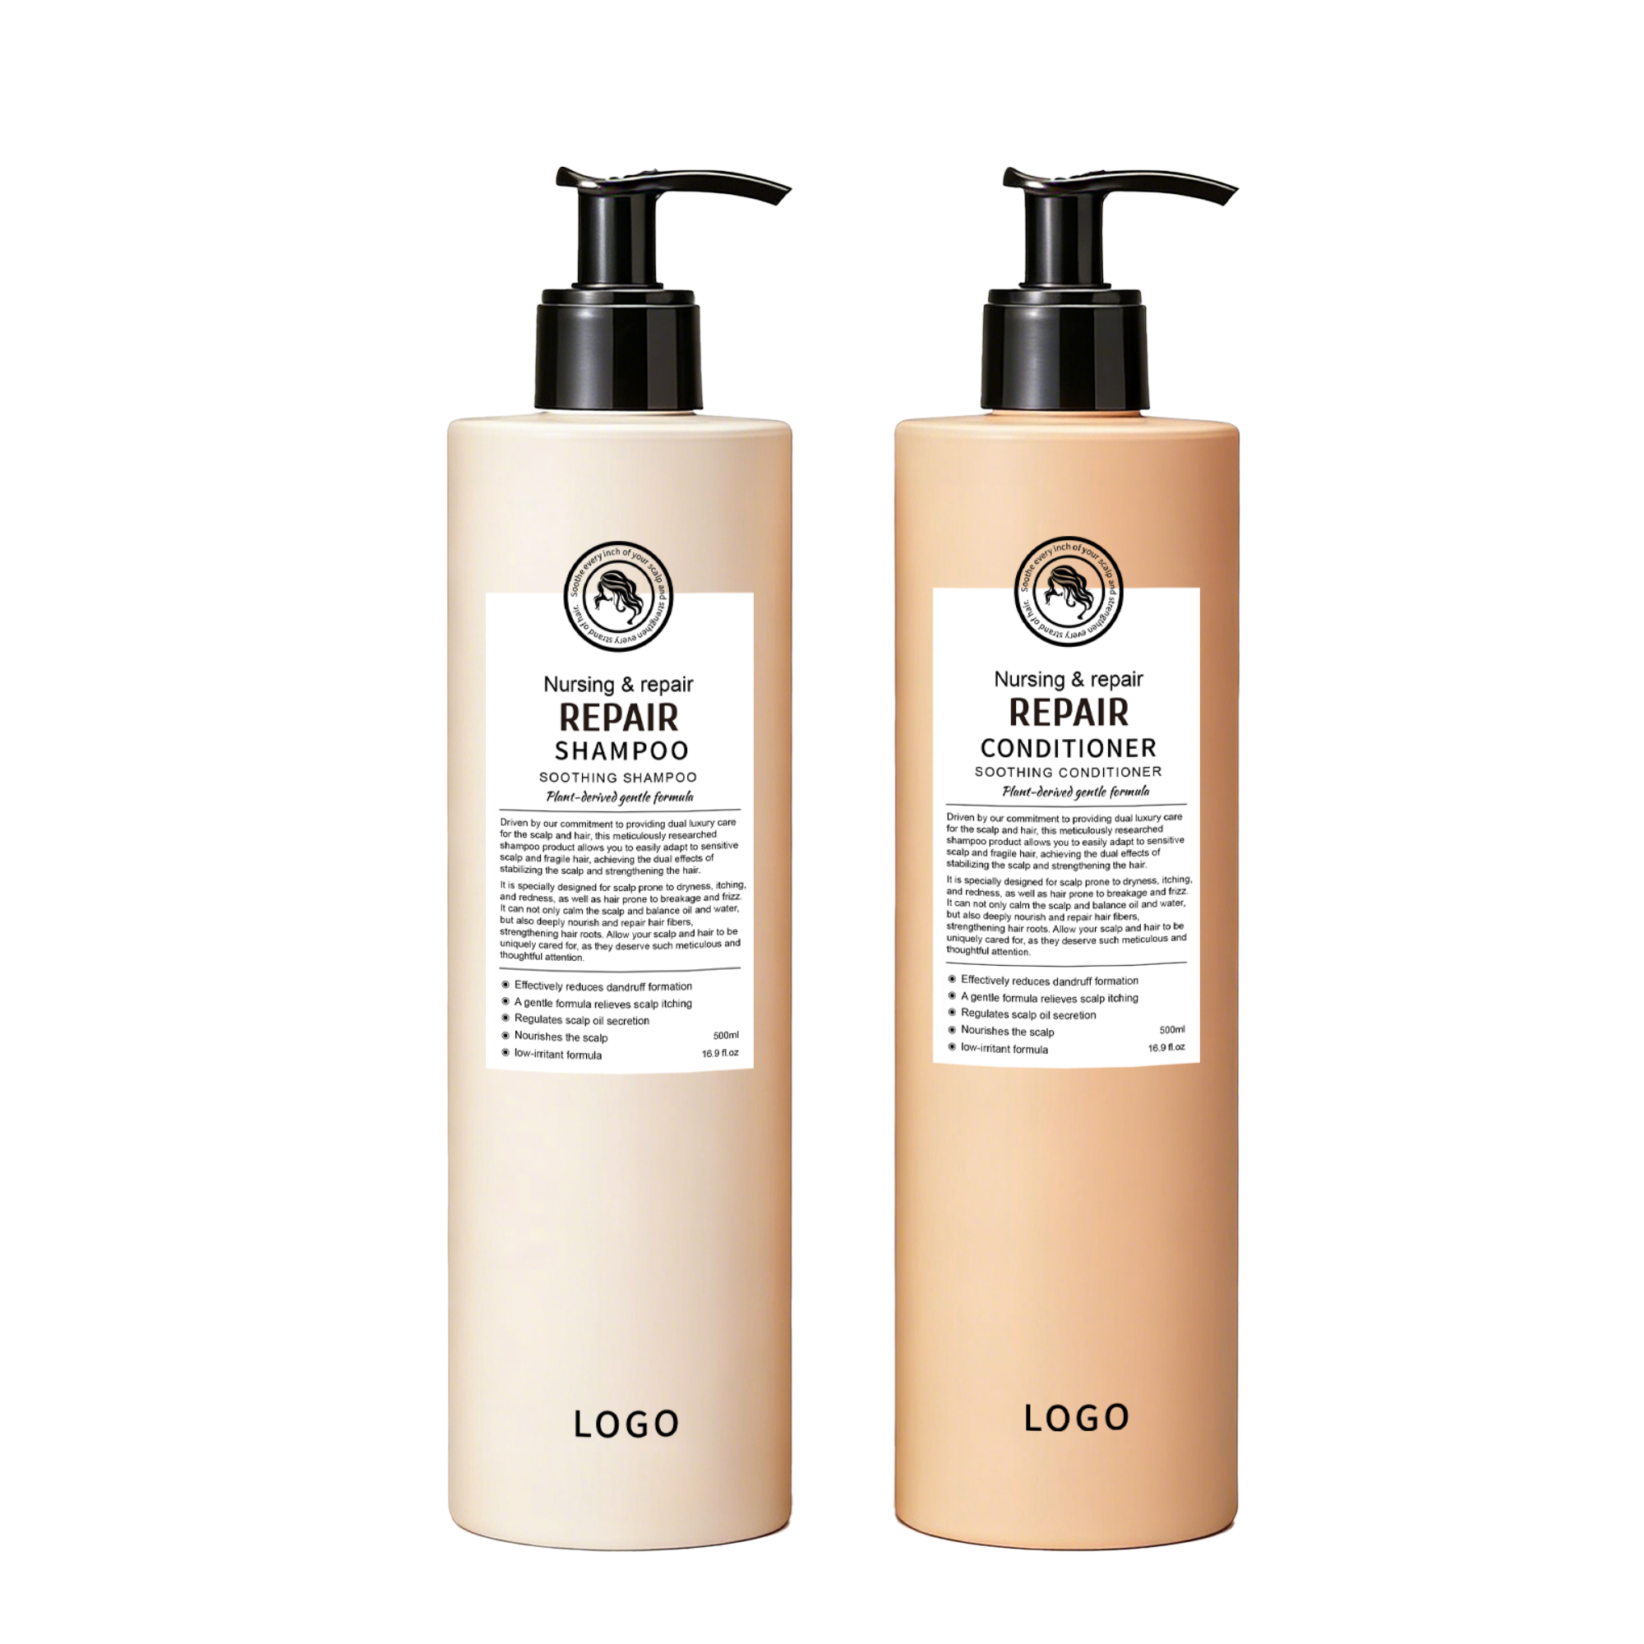
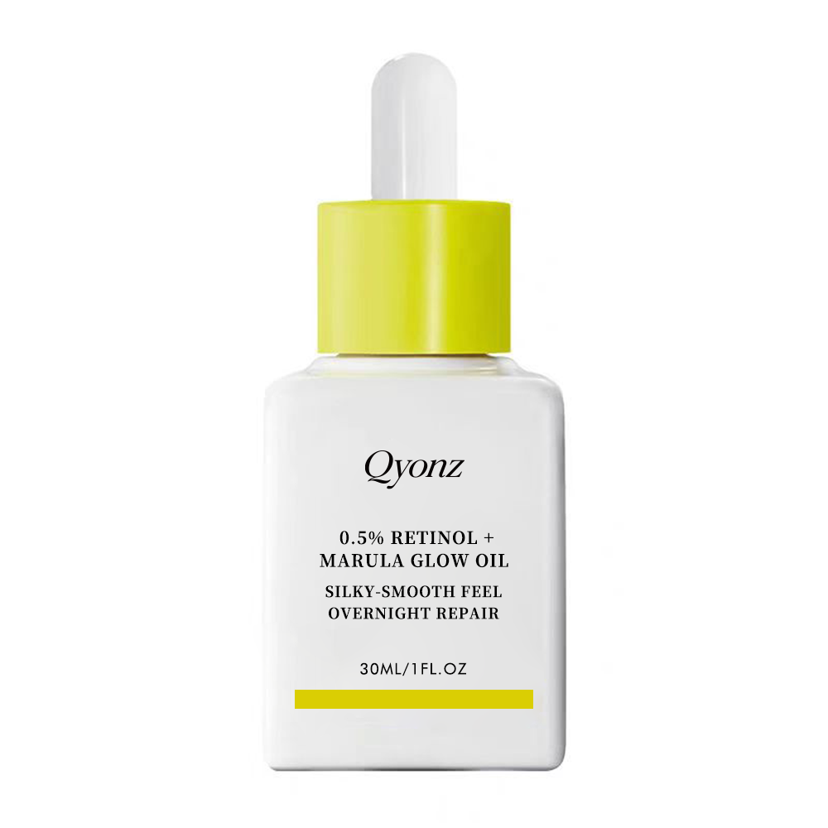
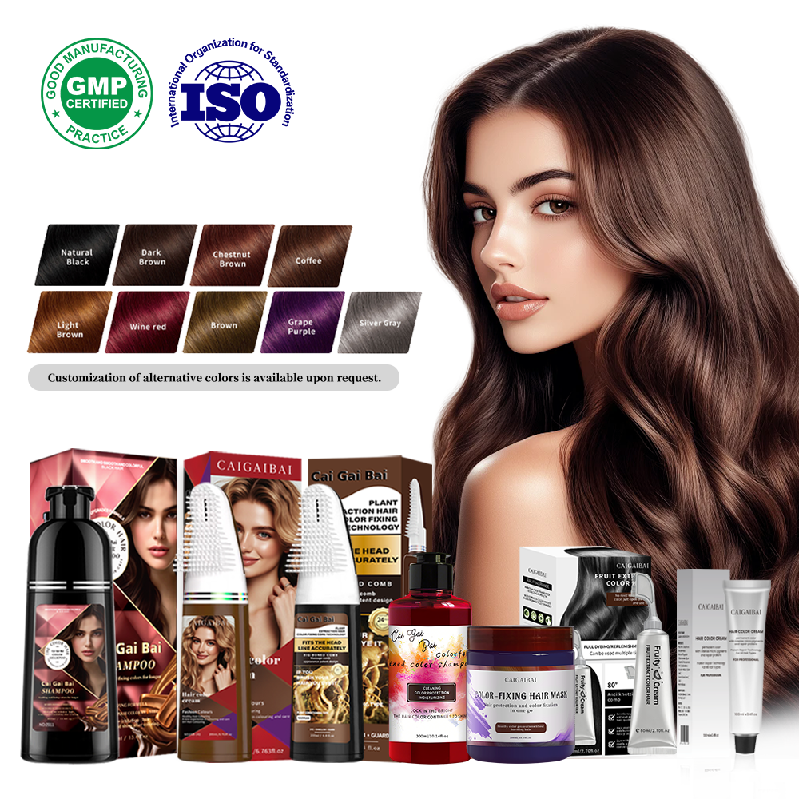
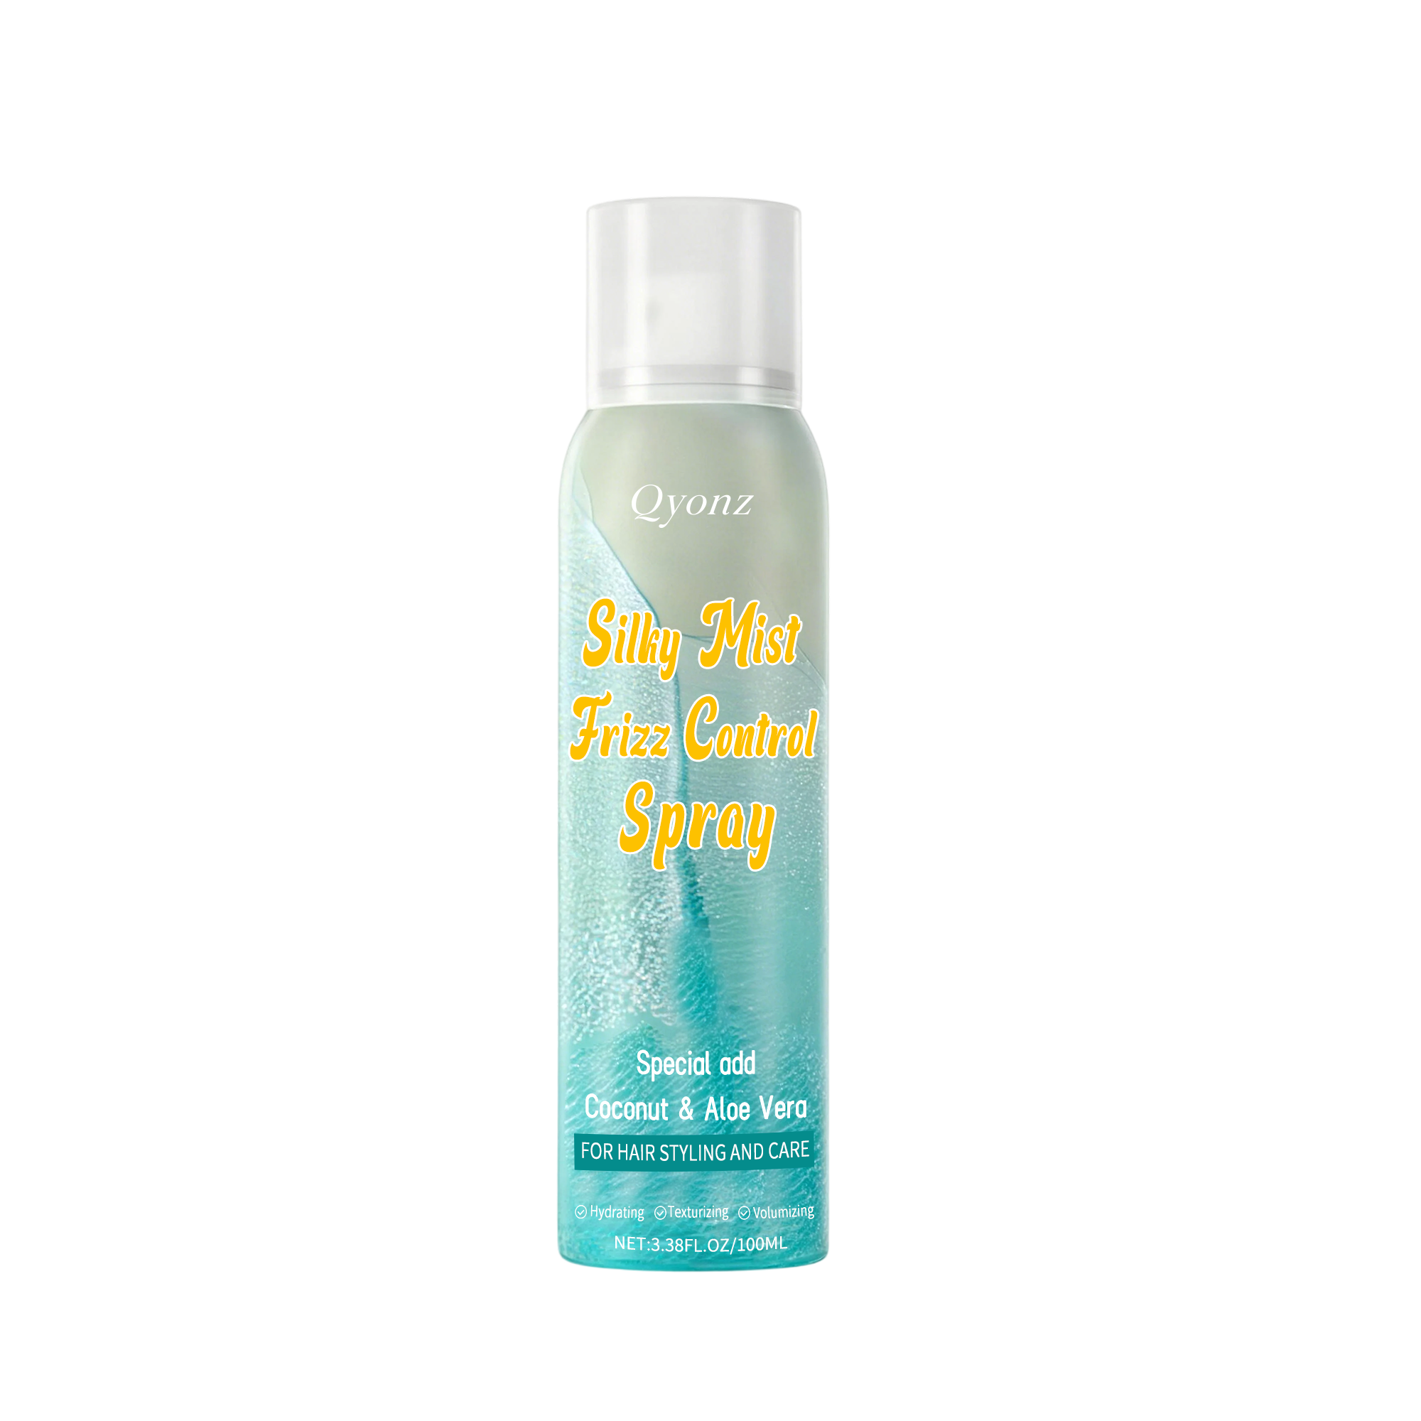
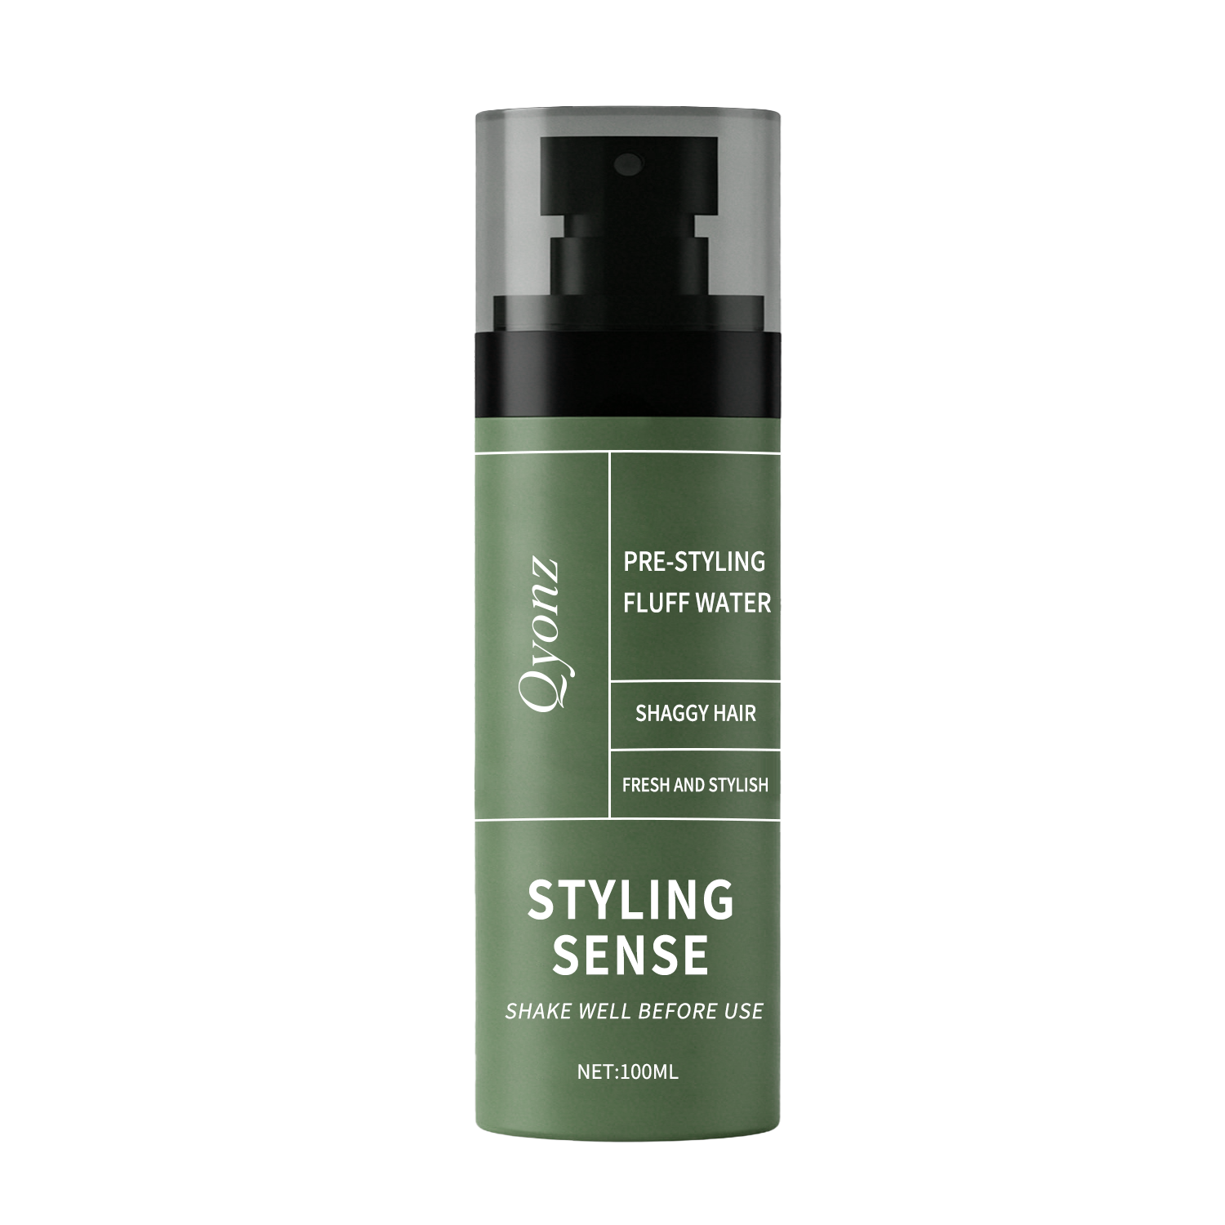
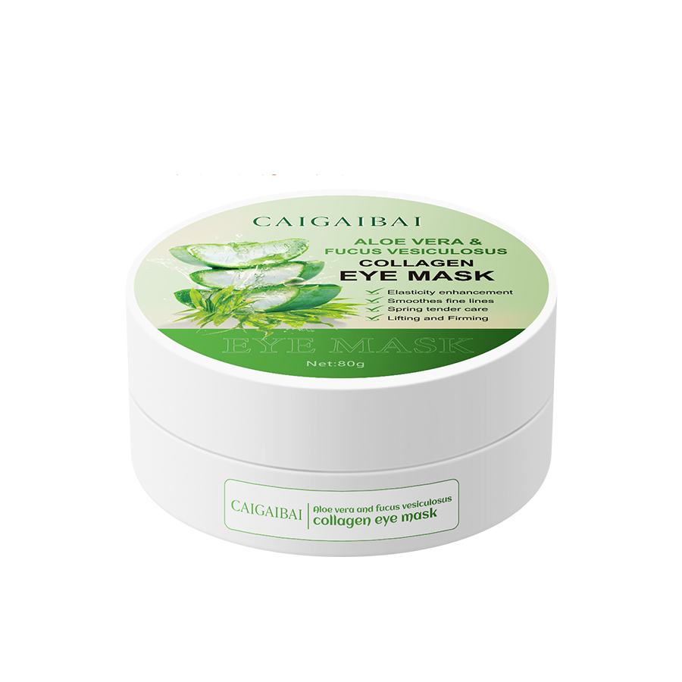
QYONZ
CORE CATEGORIES
Highlighting scalable product groups instead of scattered single SKUs
HAIRCARE
SKINCARE
HAIR COLOR
SHAMPOO, CONDITIONER, HAIR MASK, SCALP CARE
SERUM, CREAM, LOTION, FACIAL CARE, BODY CARE
HERBAL COLOR, COLOR-DEPOSITING, TONING CARE
OEM
ODM
MIXED ORDERS
OEM
ODM
MIXED ORDERS
OEM
ODM
MIXED ORDERS
FRAGRANCE
STYLING
BODY CARE
PERFUME, BODY MIST, SCENTED SUPPORTING ITEMS
SPRAY, OIL, HOLDING AND FINISHING SOLUTIONS
BODY CREAM, OIL, SCRUB AND PERSONAL CARE
OEM
ODM
MIXED ORDERS
OEM
ODM
MIXED ORDERS
OEM
ODM
MIXED ORDERS
FOR WEBSITE USE, CATEGORY-BASED PRESENTATION MAKES THE FACTORY LOOK MORE STRUCTURED, CAPABLE AND TRUSTWORTHY.
3

Slide 4
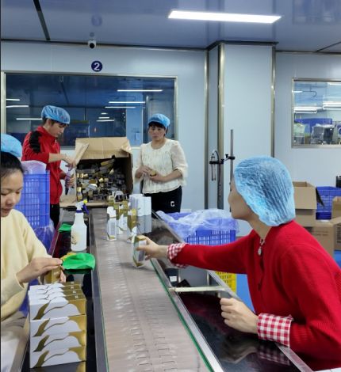
QYONZ
MANUFACTURING CAPABILITY
What international buyers want to understand before they move forward
01
02
PRODUCTION LINES
2 AUTOMATIC LINES
10 SEMI-AUTOMATIC LINES
WORKSHOP STANDARD
GMP WORKSHOP
100,000-CLASS CLEAN AREA
03
04
SAMPLE TIMELINE
USUALLY 3–7
WORKING DAYS
MOQ FLEXIBILITY
ABOUT 500 PCS / SKU
WITH EXISTING PACKAGING
05
06
LEAD TIME
NEW PACKAGING PROJECTS
USUALLY 25–35 DAYS
PAYMENT TERMS
COMMONLY DISCUSSED
BY PROJECT STAGE
THE KEY MESSAGE HERE IS NOT ONLY CAPACITY, BUT ALSO EXECUTION SPEED, MOQ FLEXIBILITY AND DELIVERY RHYTHM.
4
Notes:
[Sources] /mnt/data/生产线1.JPG

Slide 5
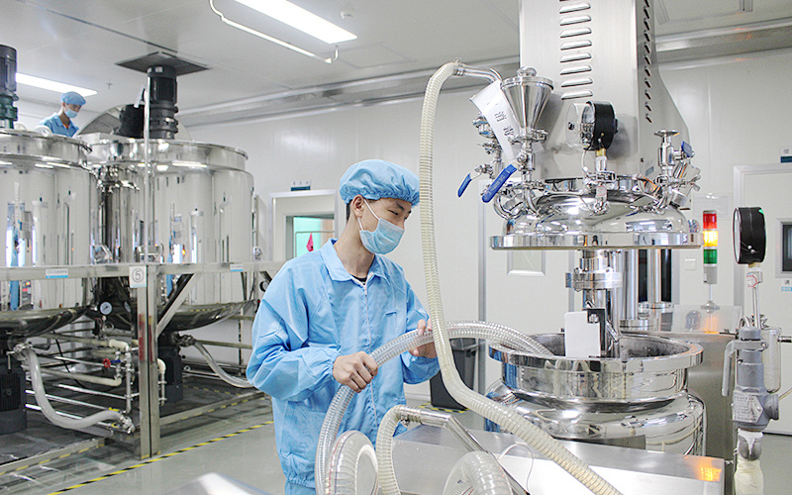
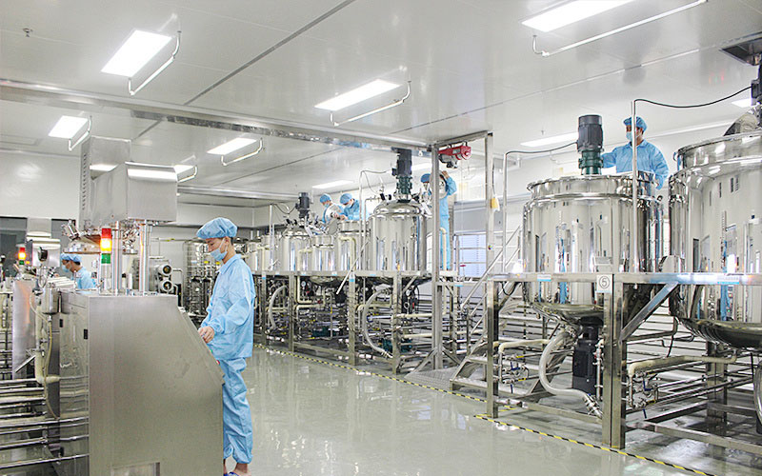
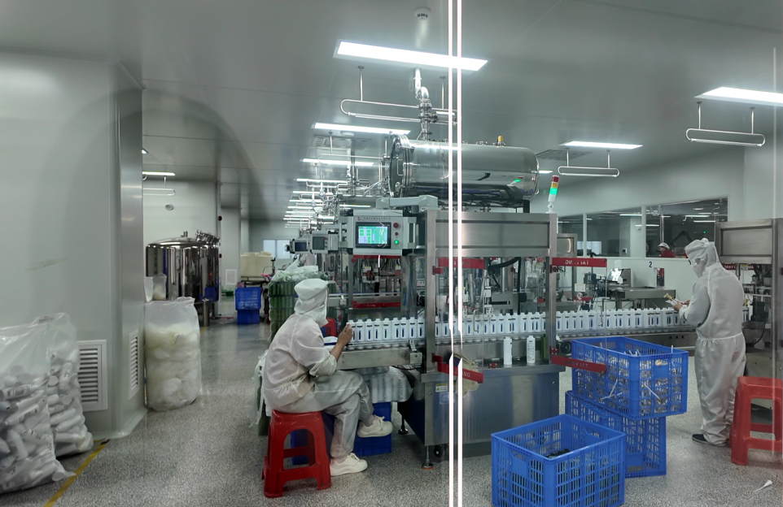
QYONZ
FACTORY INTERIOR GALLERY
More internal factory visuals to strengthen trust and perceived capability
LAB
QC
FILLING AREA
PRODUCTION
WORKSHOP
CLEAN ROOM
5

Slide 6
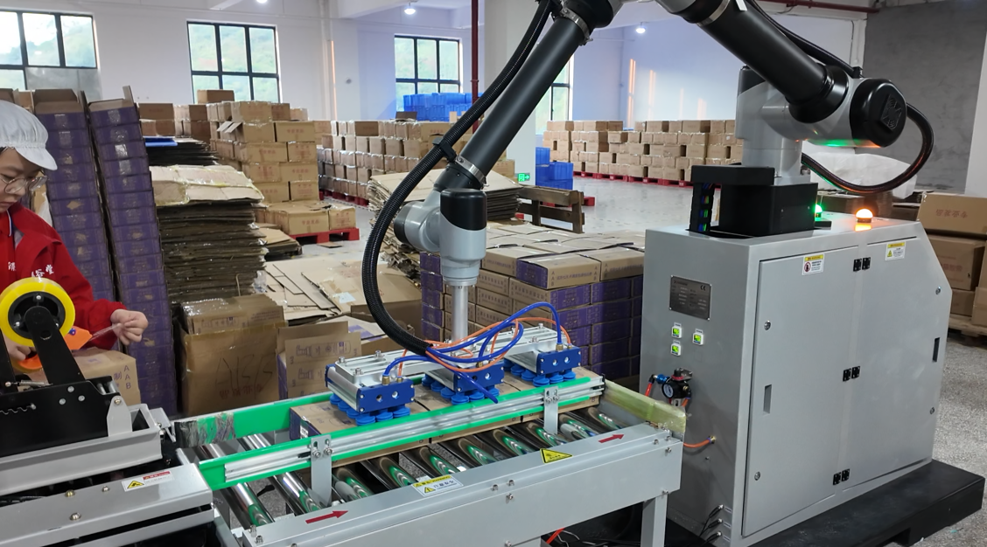
QYONZ
R&D AND QC
Development, verification and refinement are part of the same workflow
HOW WE SUPPORT DEVELOPMENT
• Formula direction can be discussed by target market, budget and category positioning.
• Existing mature formulas and adjusted samples can both be used for faster project movement.
• Texture, fragrance, appearance, filling compatibility and label matching are considered together.
• Suitable for early-stage testing, launch preparation and repeat-order optimization.
WEBSITE MESSAGE
R&D, QC and sampling are connected in one execution chain, helping brands move from concept to workable samples faster.
6

Slide 7
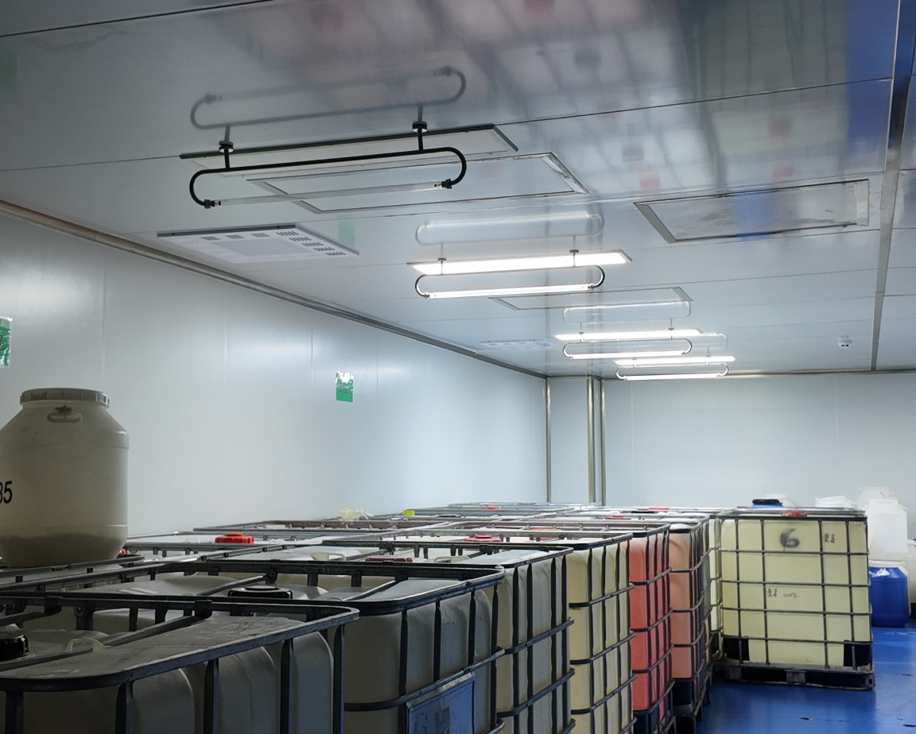
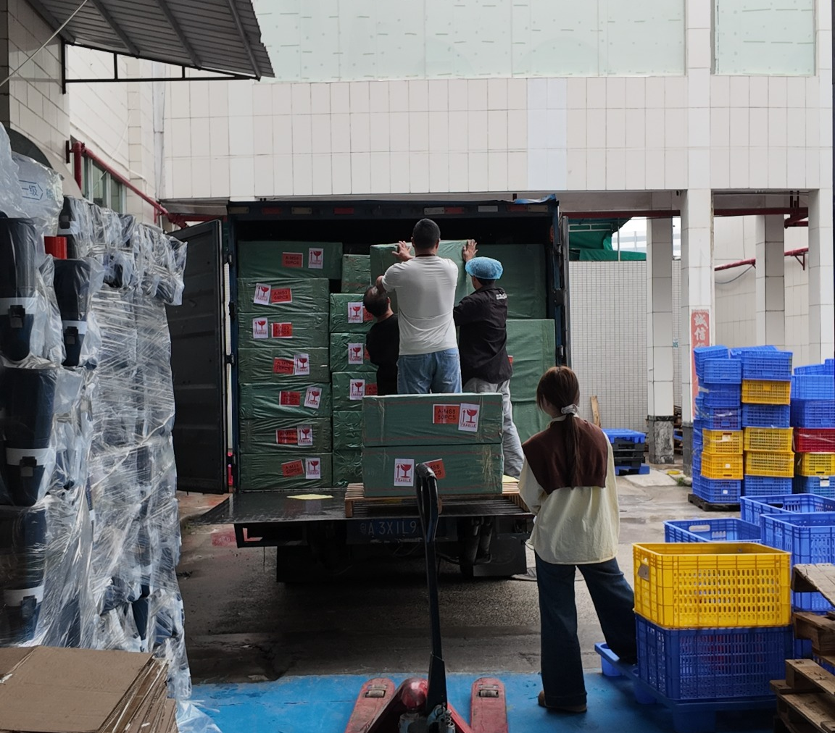
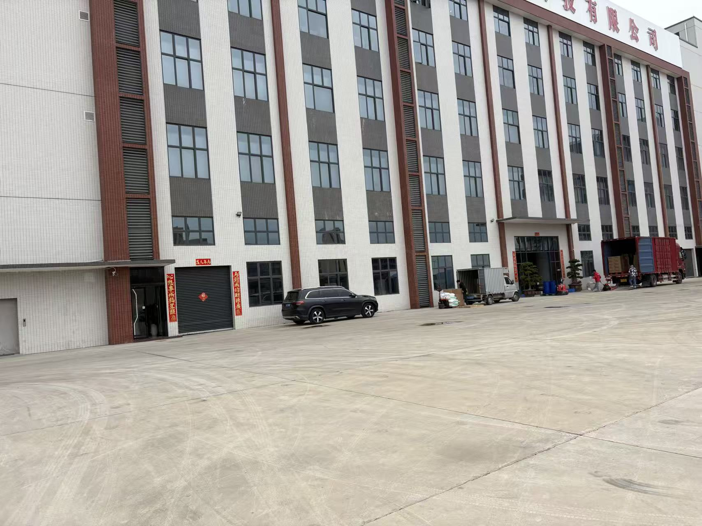
QYONZ
SUPPLY CHAIN AND WAREHOUSE
Factory coordination is not only about making products, but also about moving projects forward
1
2
3
4
5
6
7
BRIEF
FORMULA
PACKAGING
ARTWORK
PRODUCTION
DOCUMENTS
SHIPMENT
RAW MATERIALS AND STORAGE
LOADING AND DISPATCH
FACTORY BUILDING
7

Slide 8
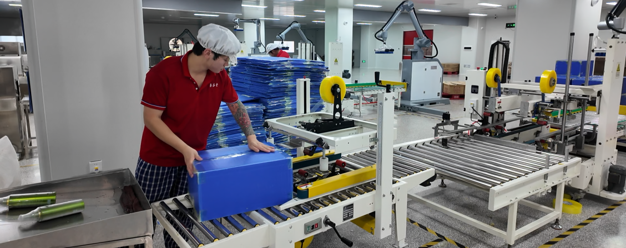
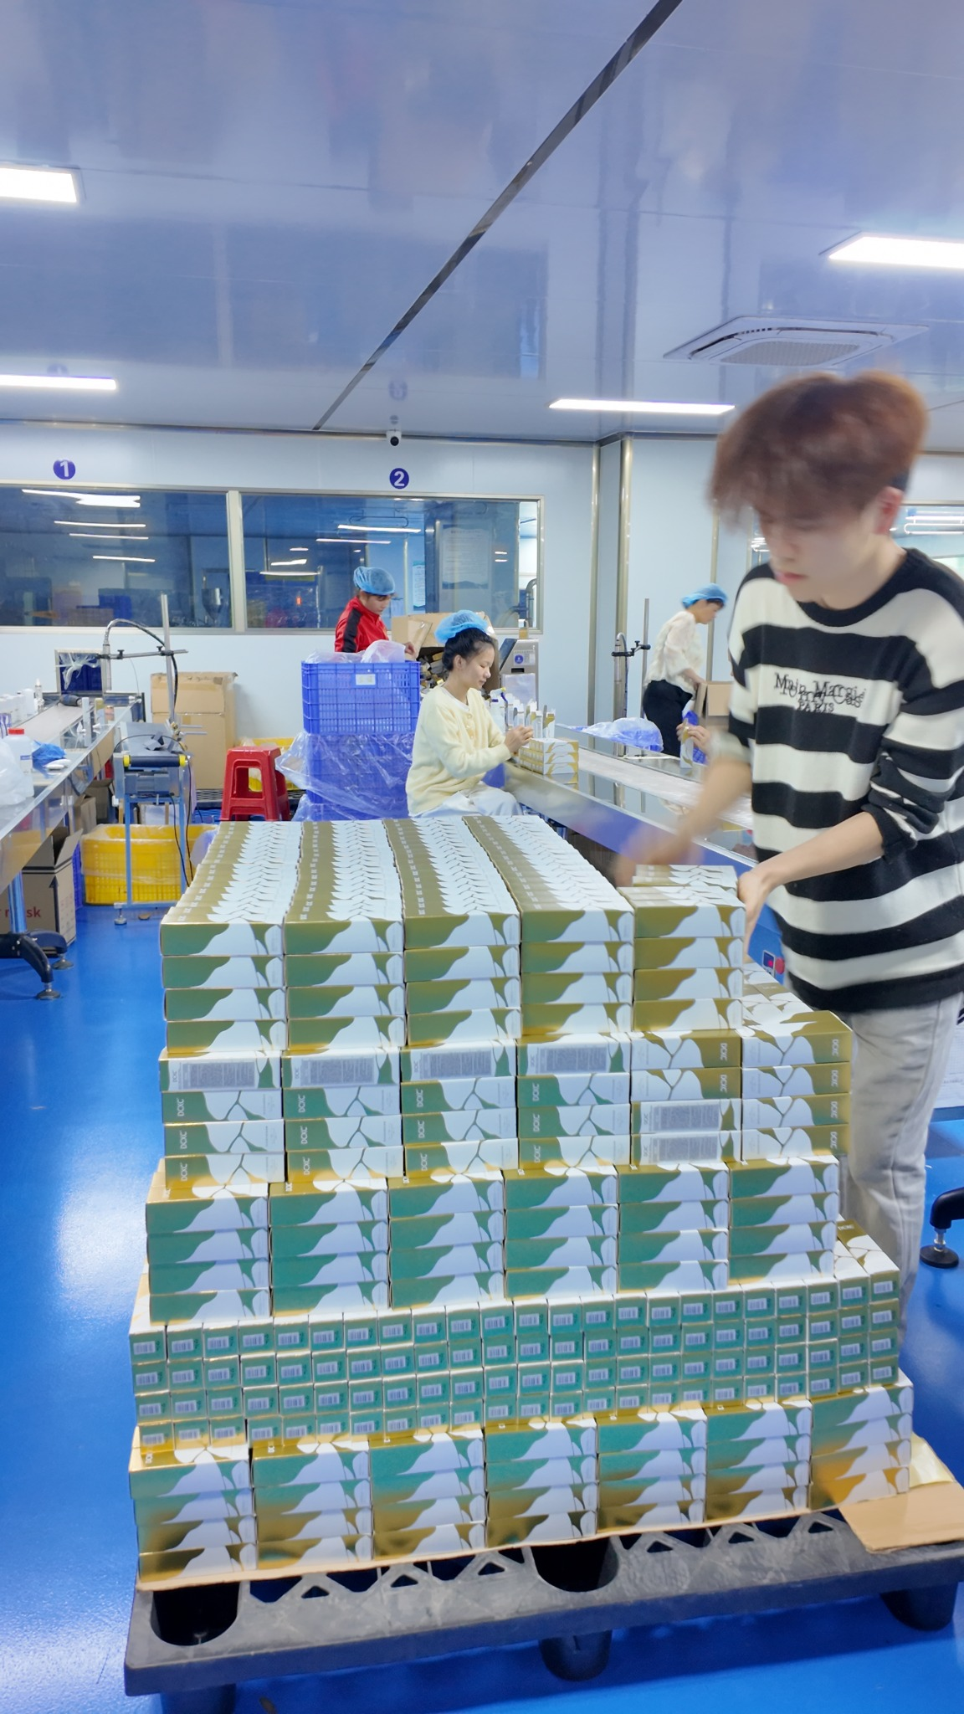
QYONZ
FILLING AND PRODUCTION FLOOR
Clearer workshop visuals help buyers believe in large-scale execution
BUYERS SHOULD SEE A CLOSED LOOP: EQUIPMENT, WORKERS, CLEAN ROOMS, FILLING, PACKING AND SHIPMENT.
8

Slide 9
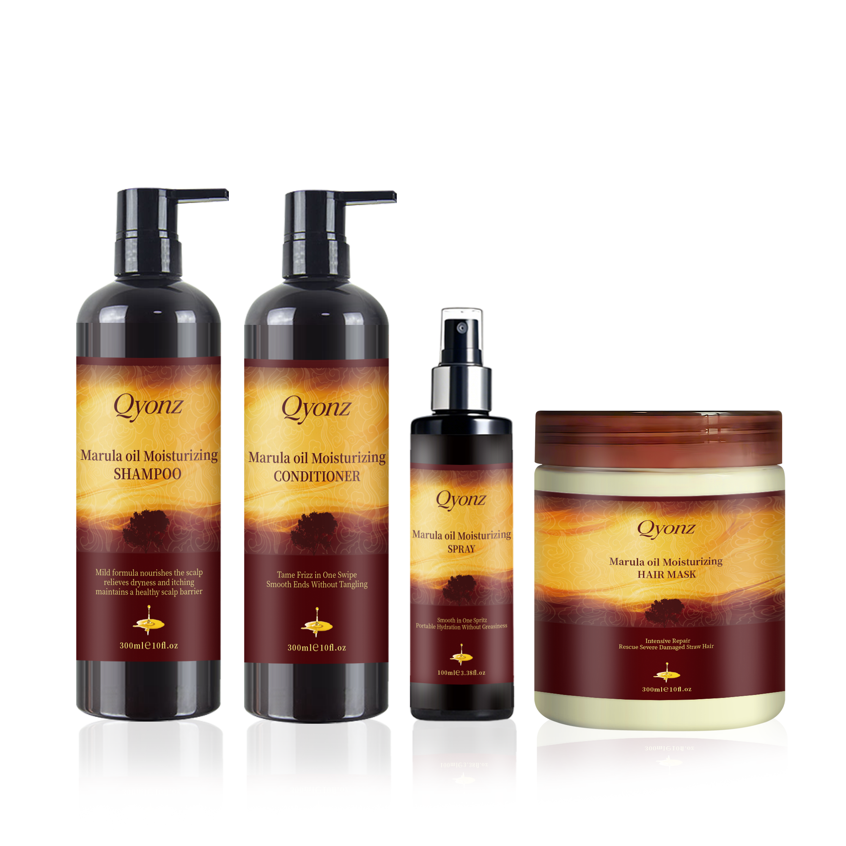
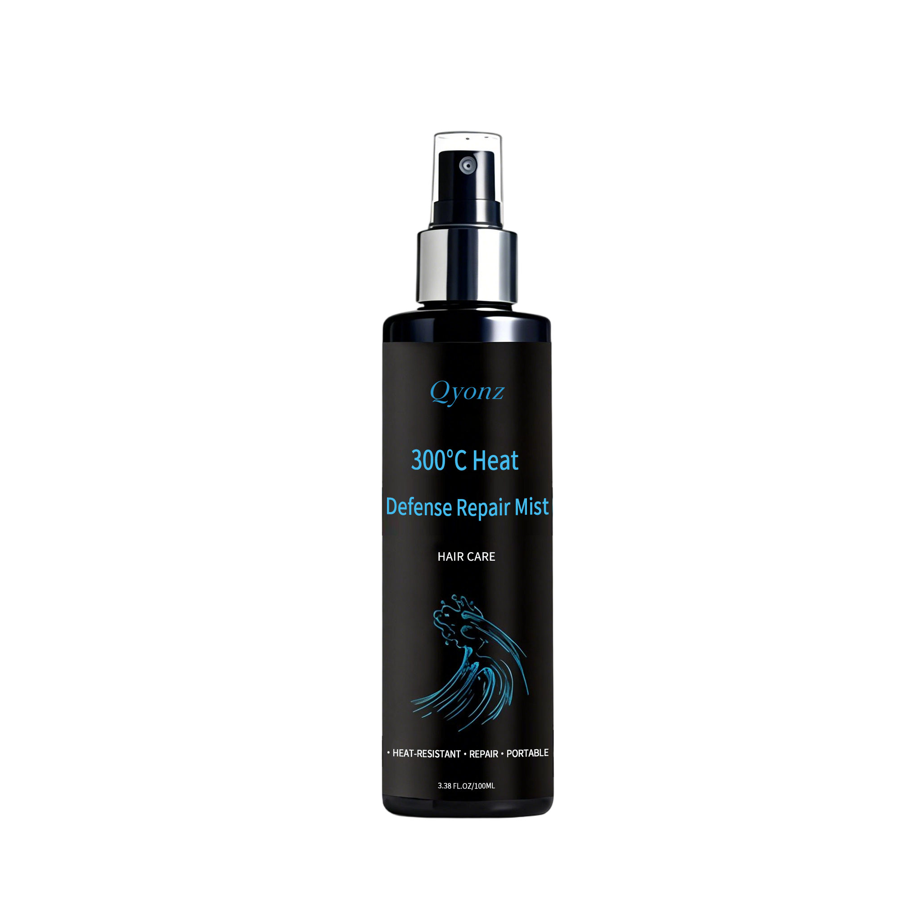
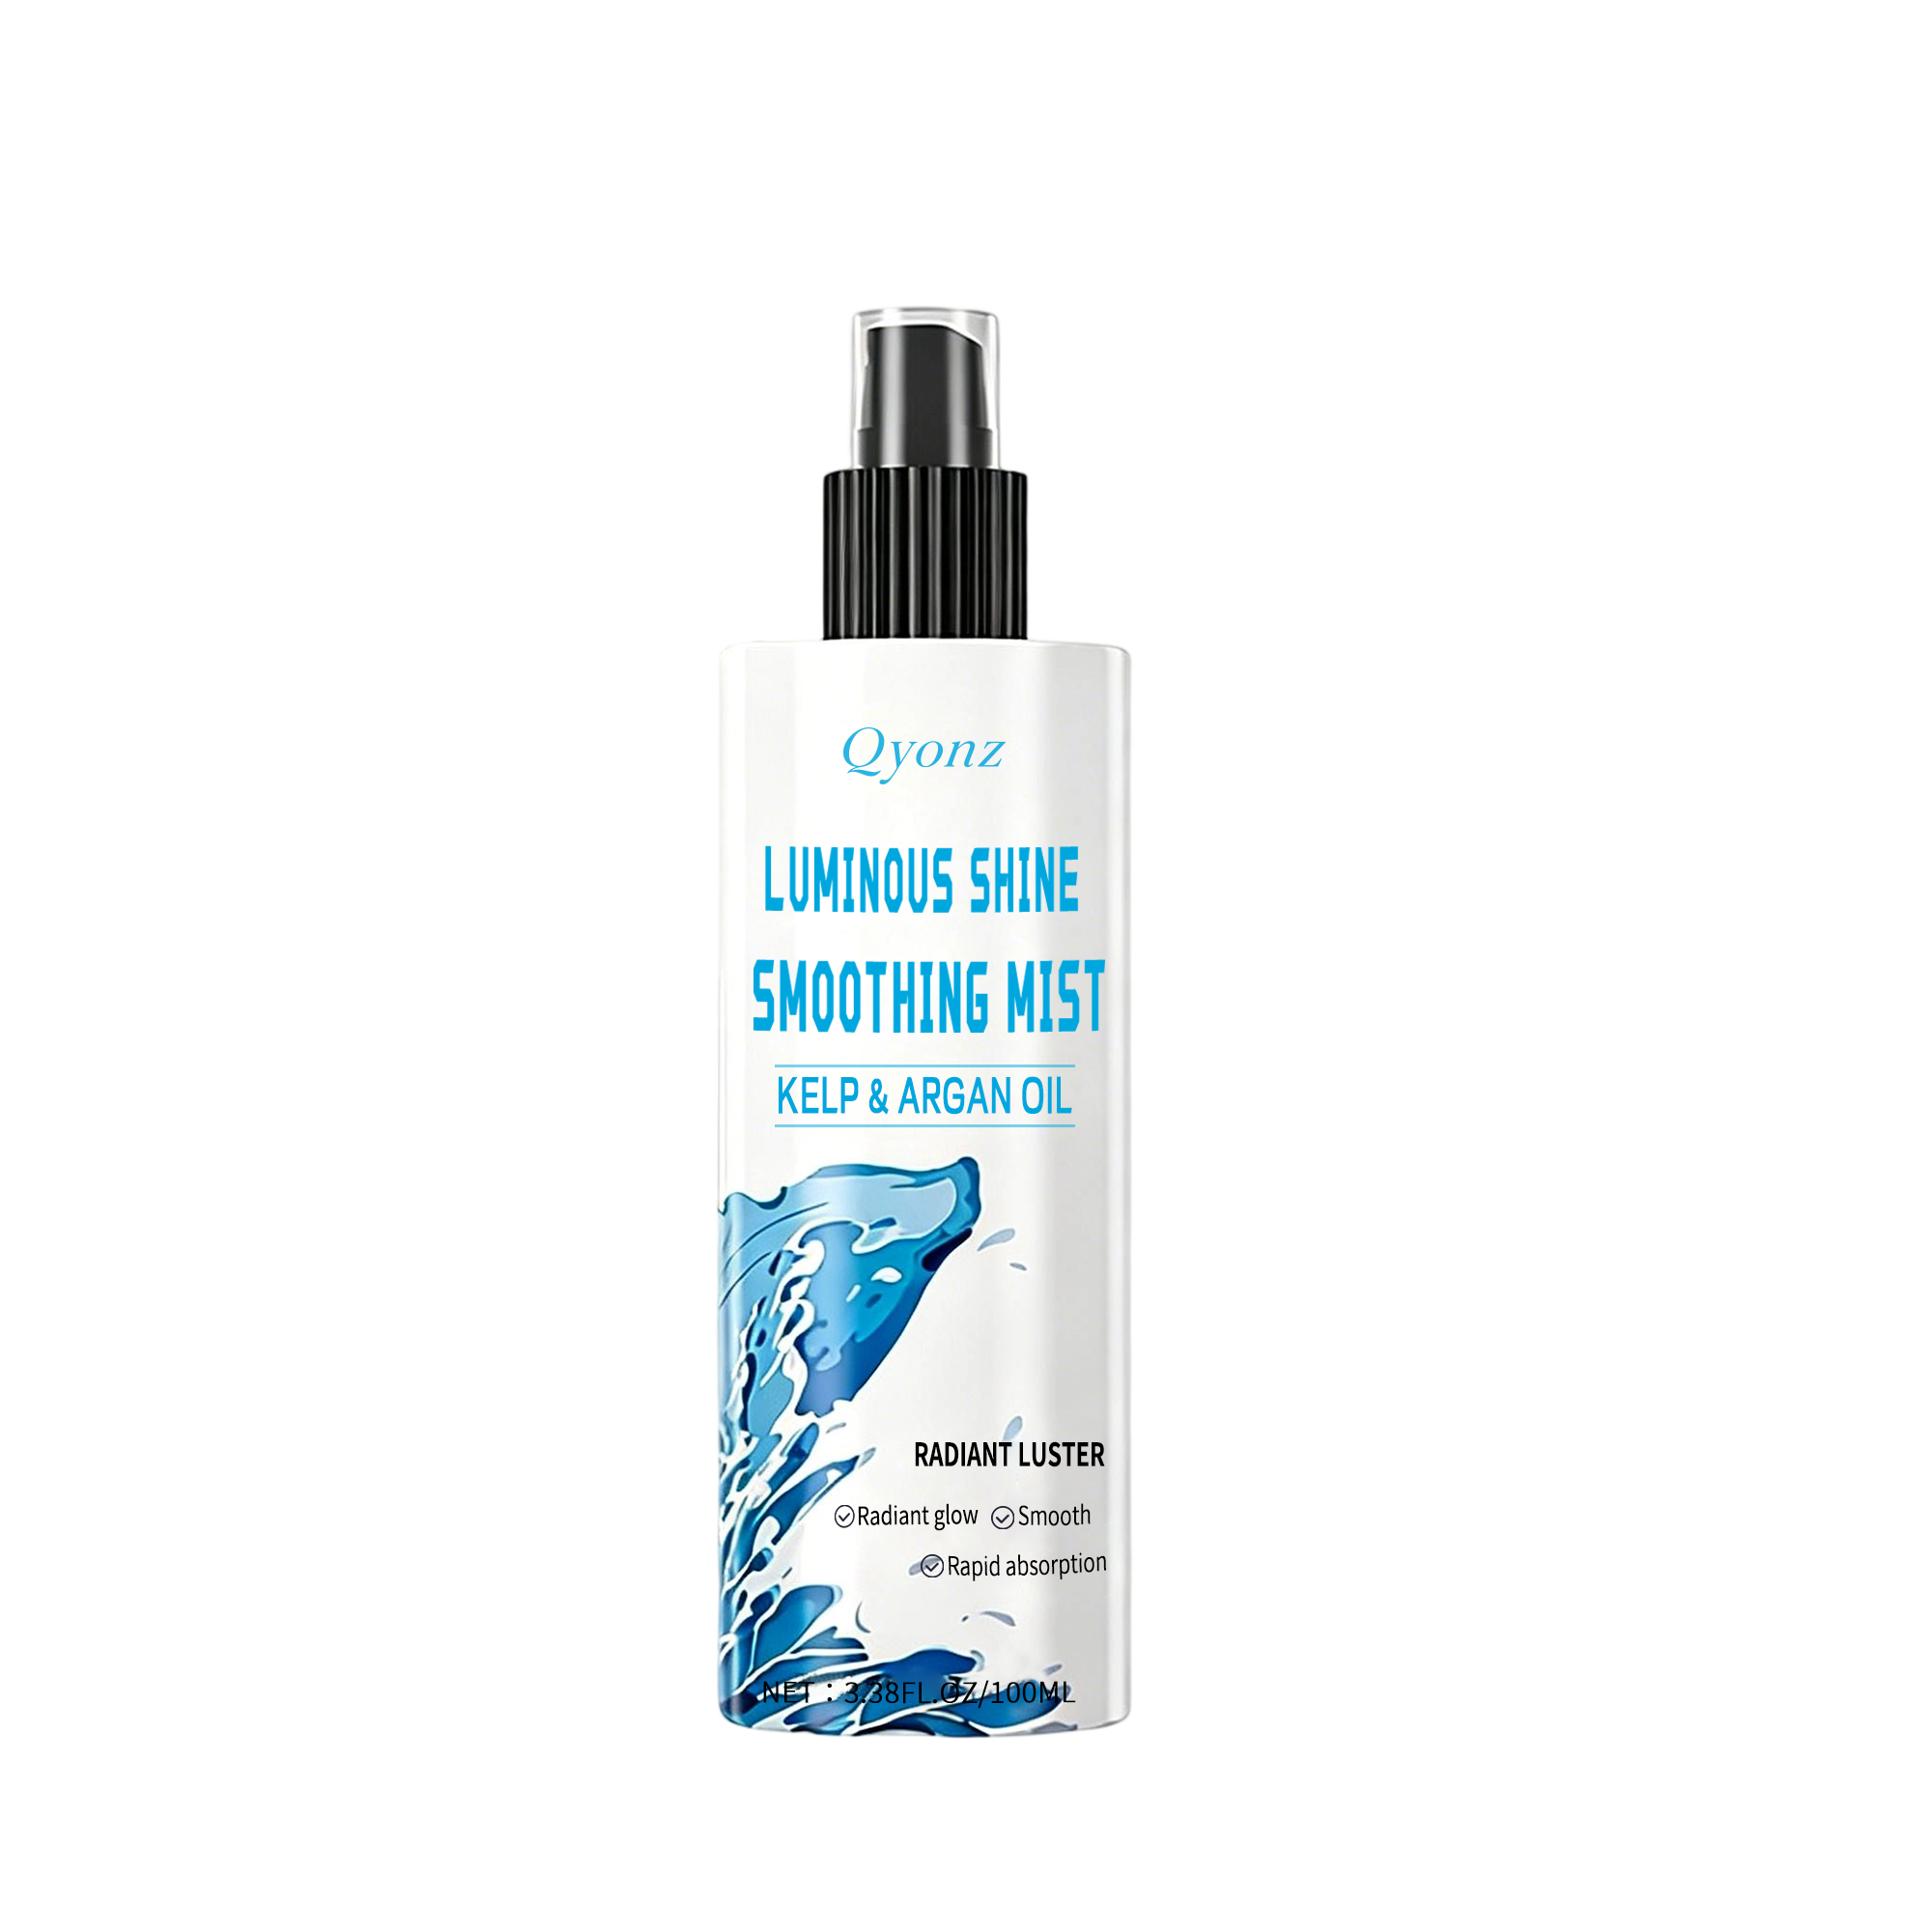
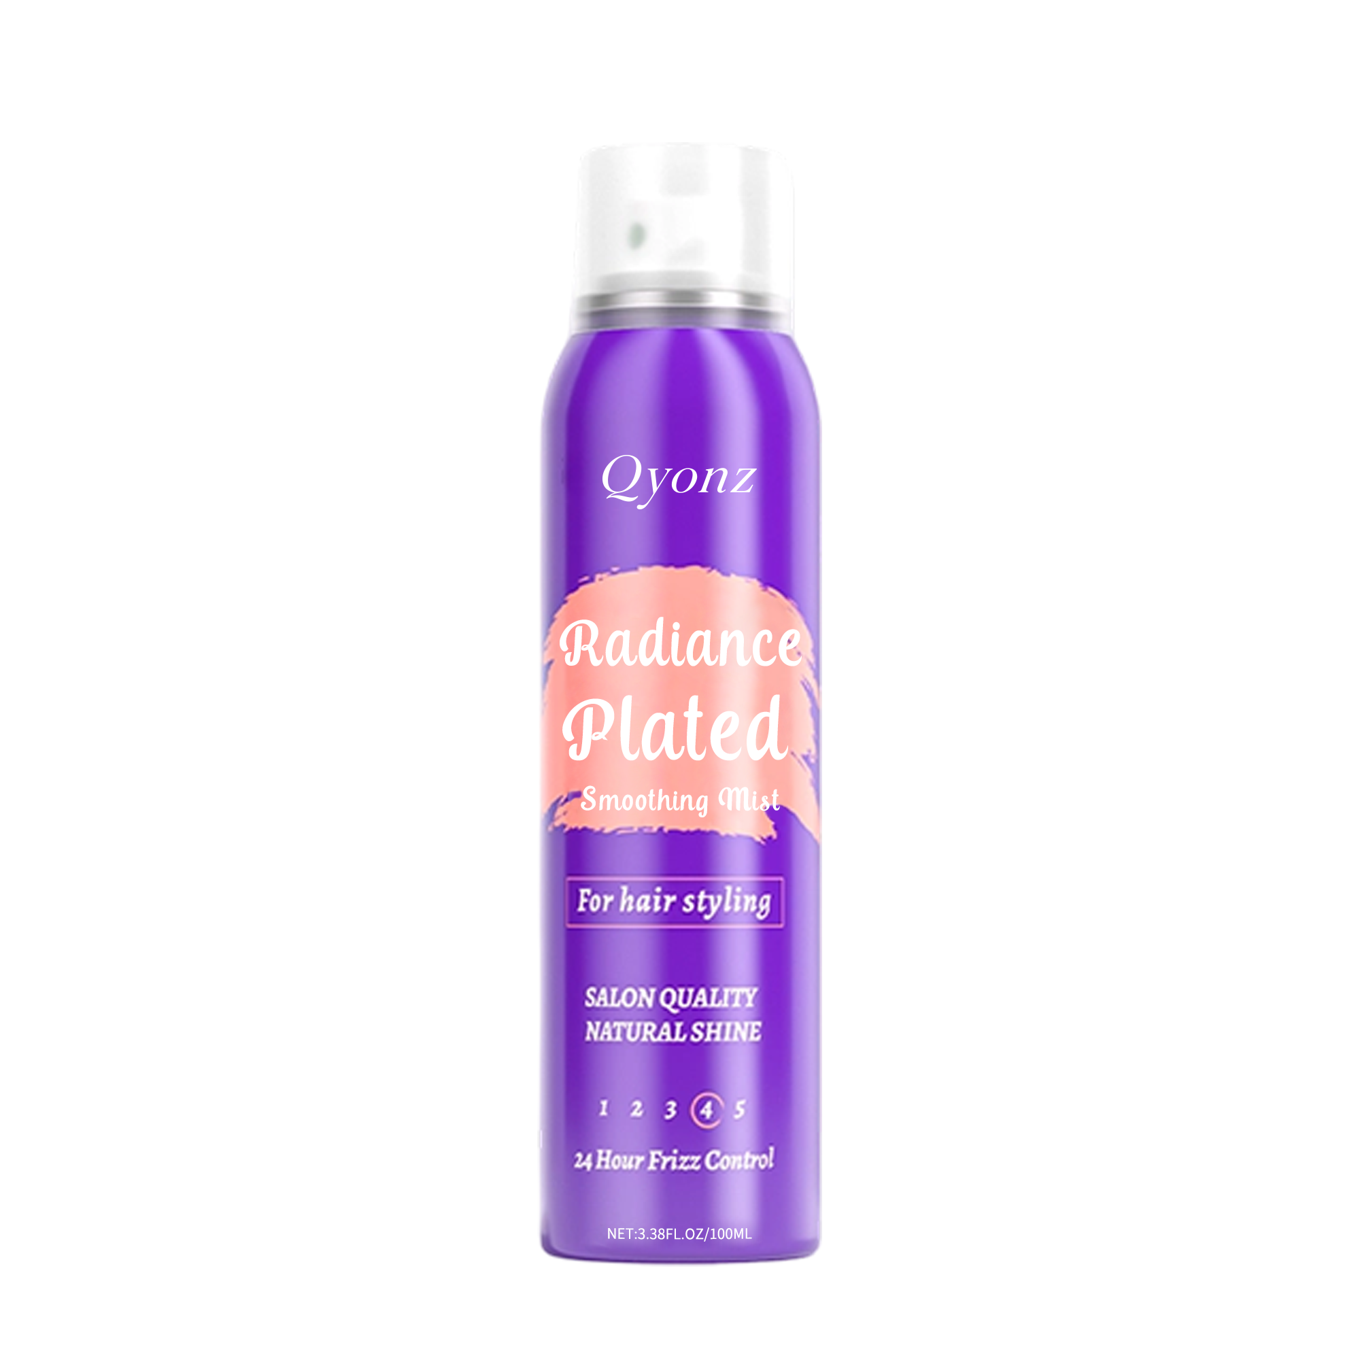
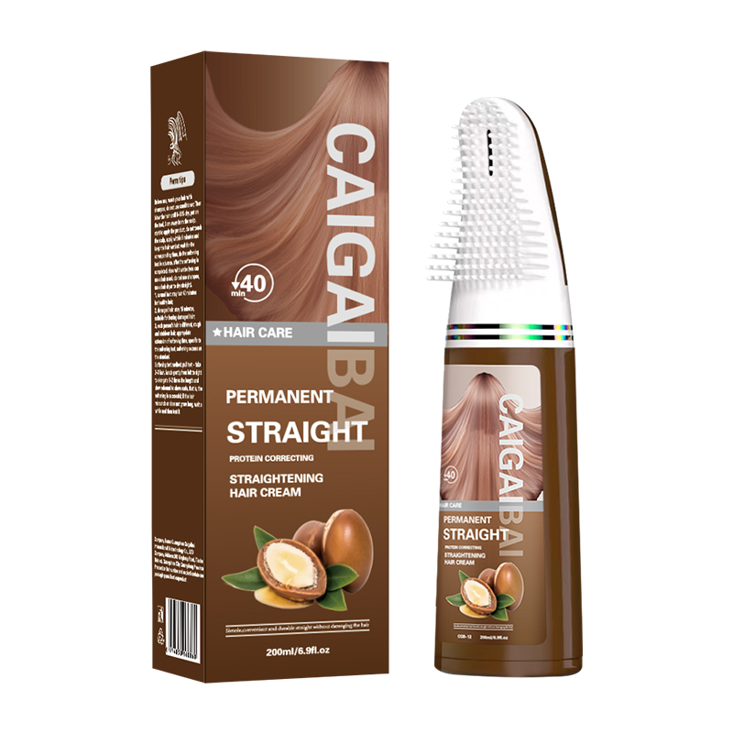
QYONZ
PRODUCT PORTFOLIO A
Selected visuals from existing products and category assets
WEBSITE PRESENTATION WORKS BEST WHEN PRODUCTS ARE SHOWN AS CATEGORY RANGE, NOT AS A LONG UNSTRUCTURED SKU LIST.
9

Slide 10
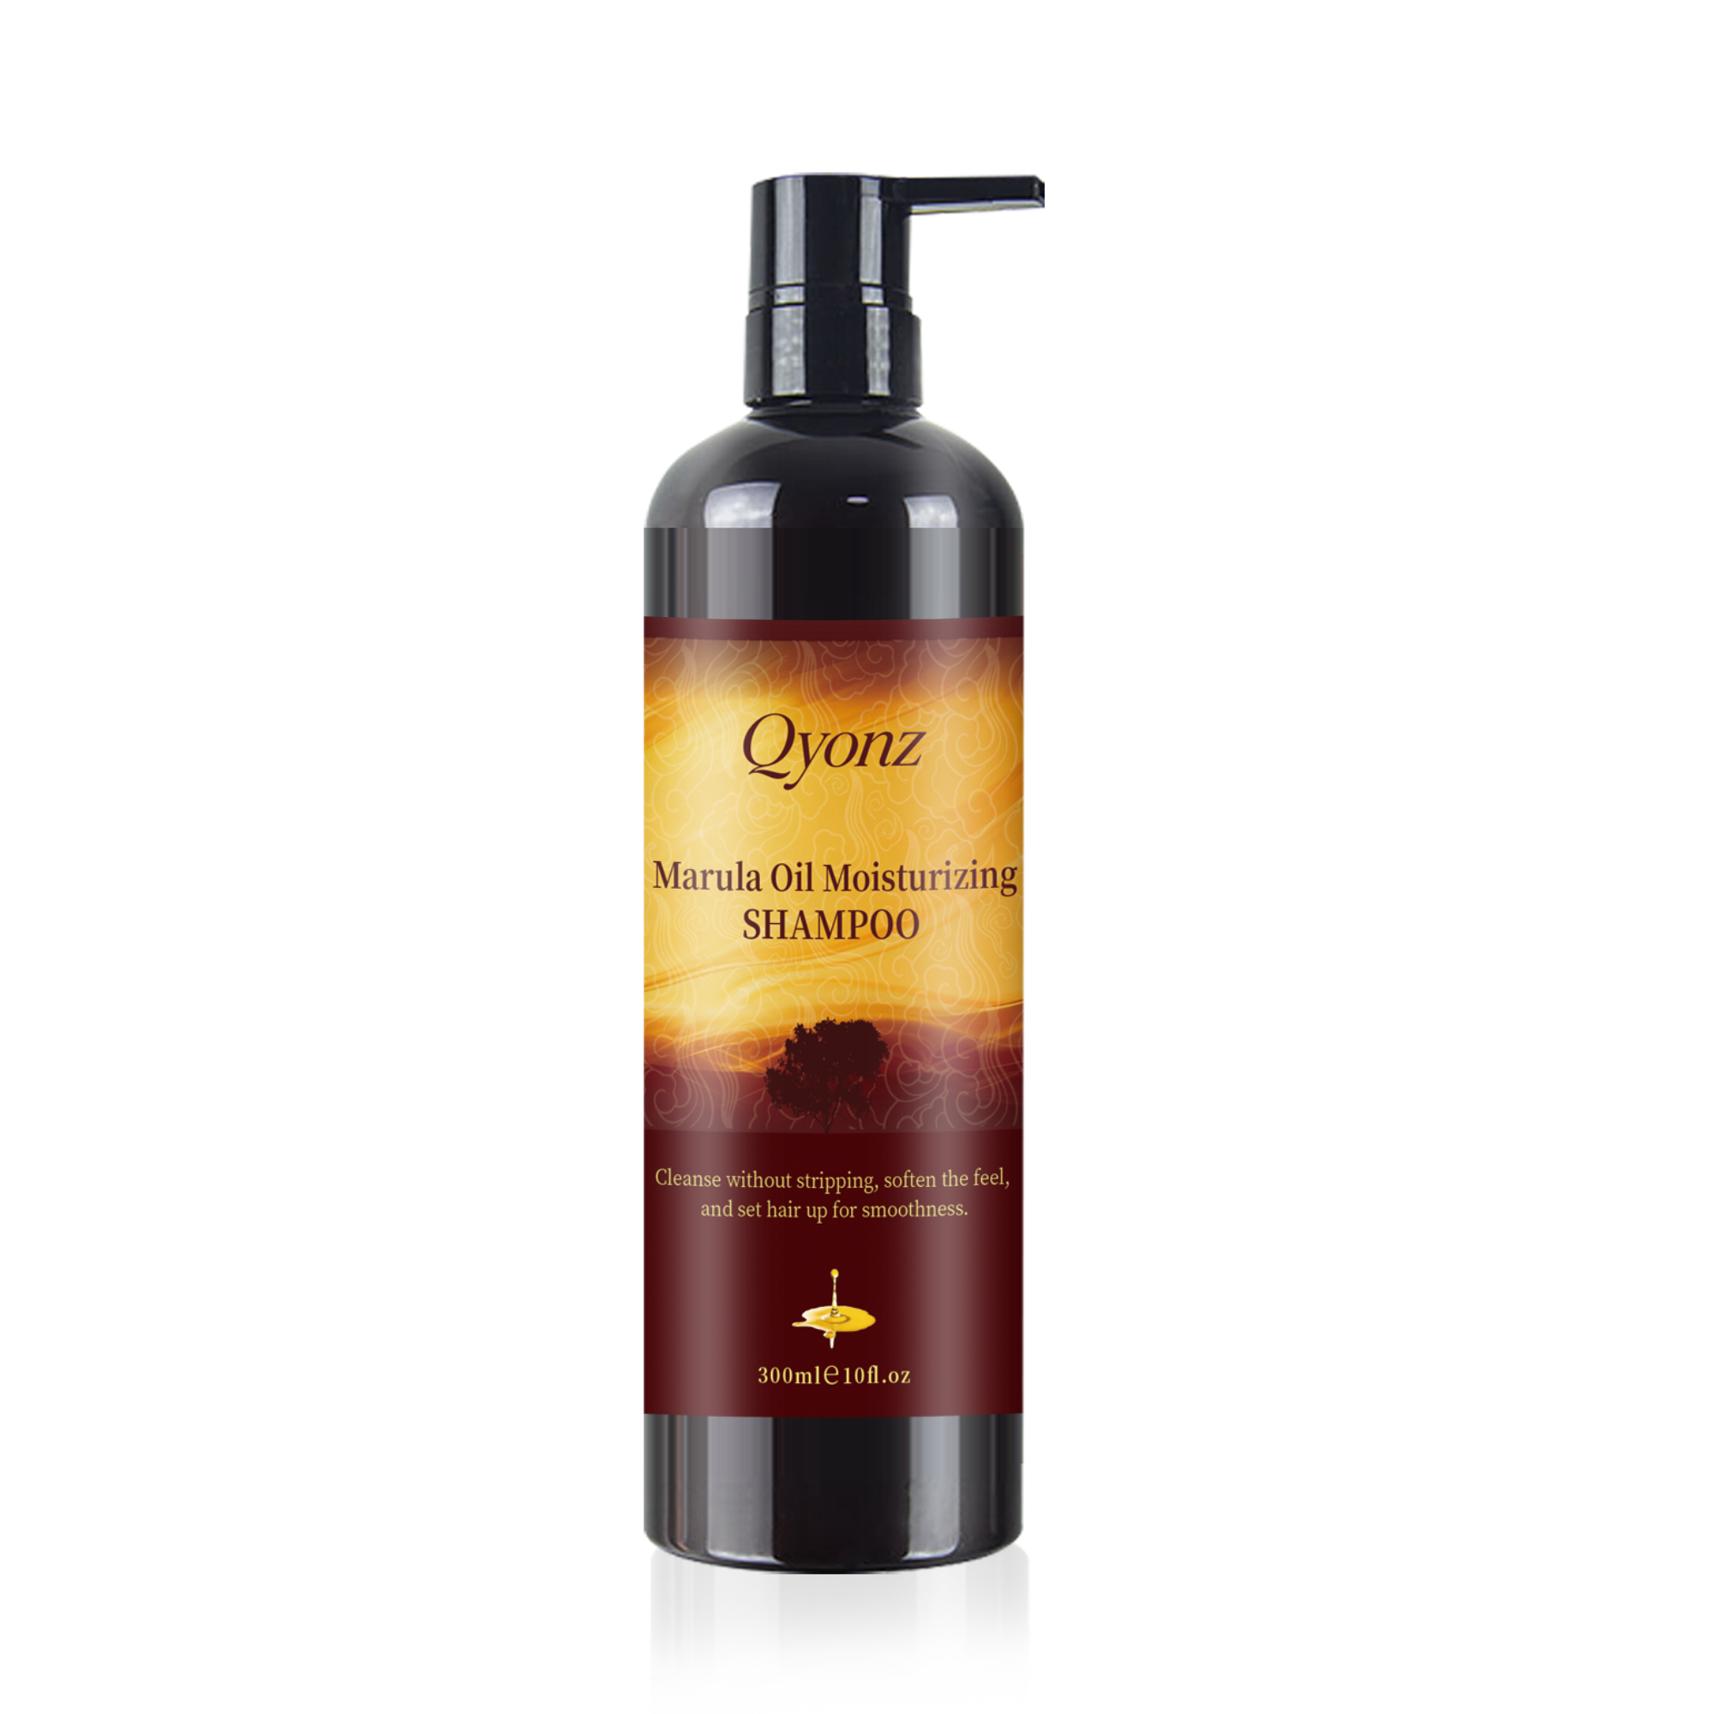
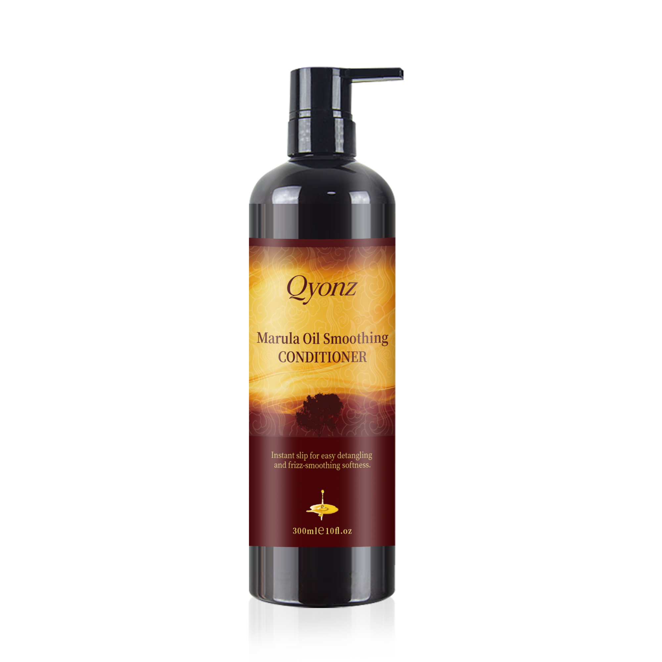
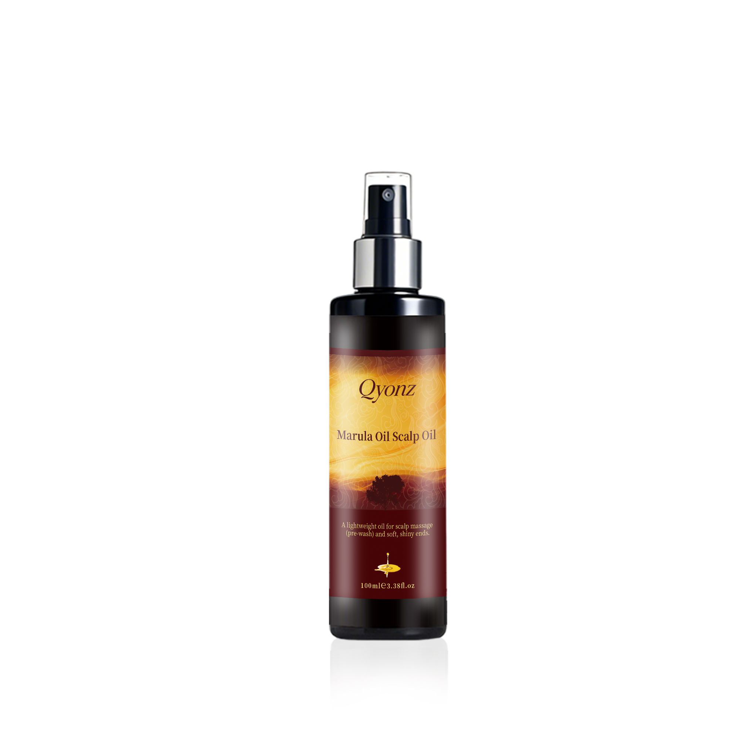
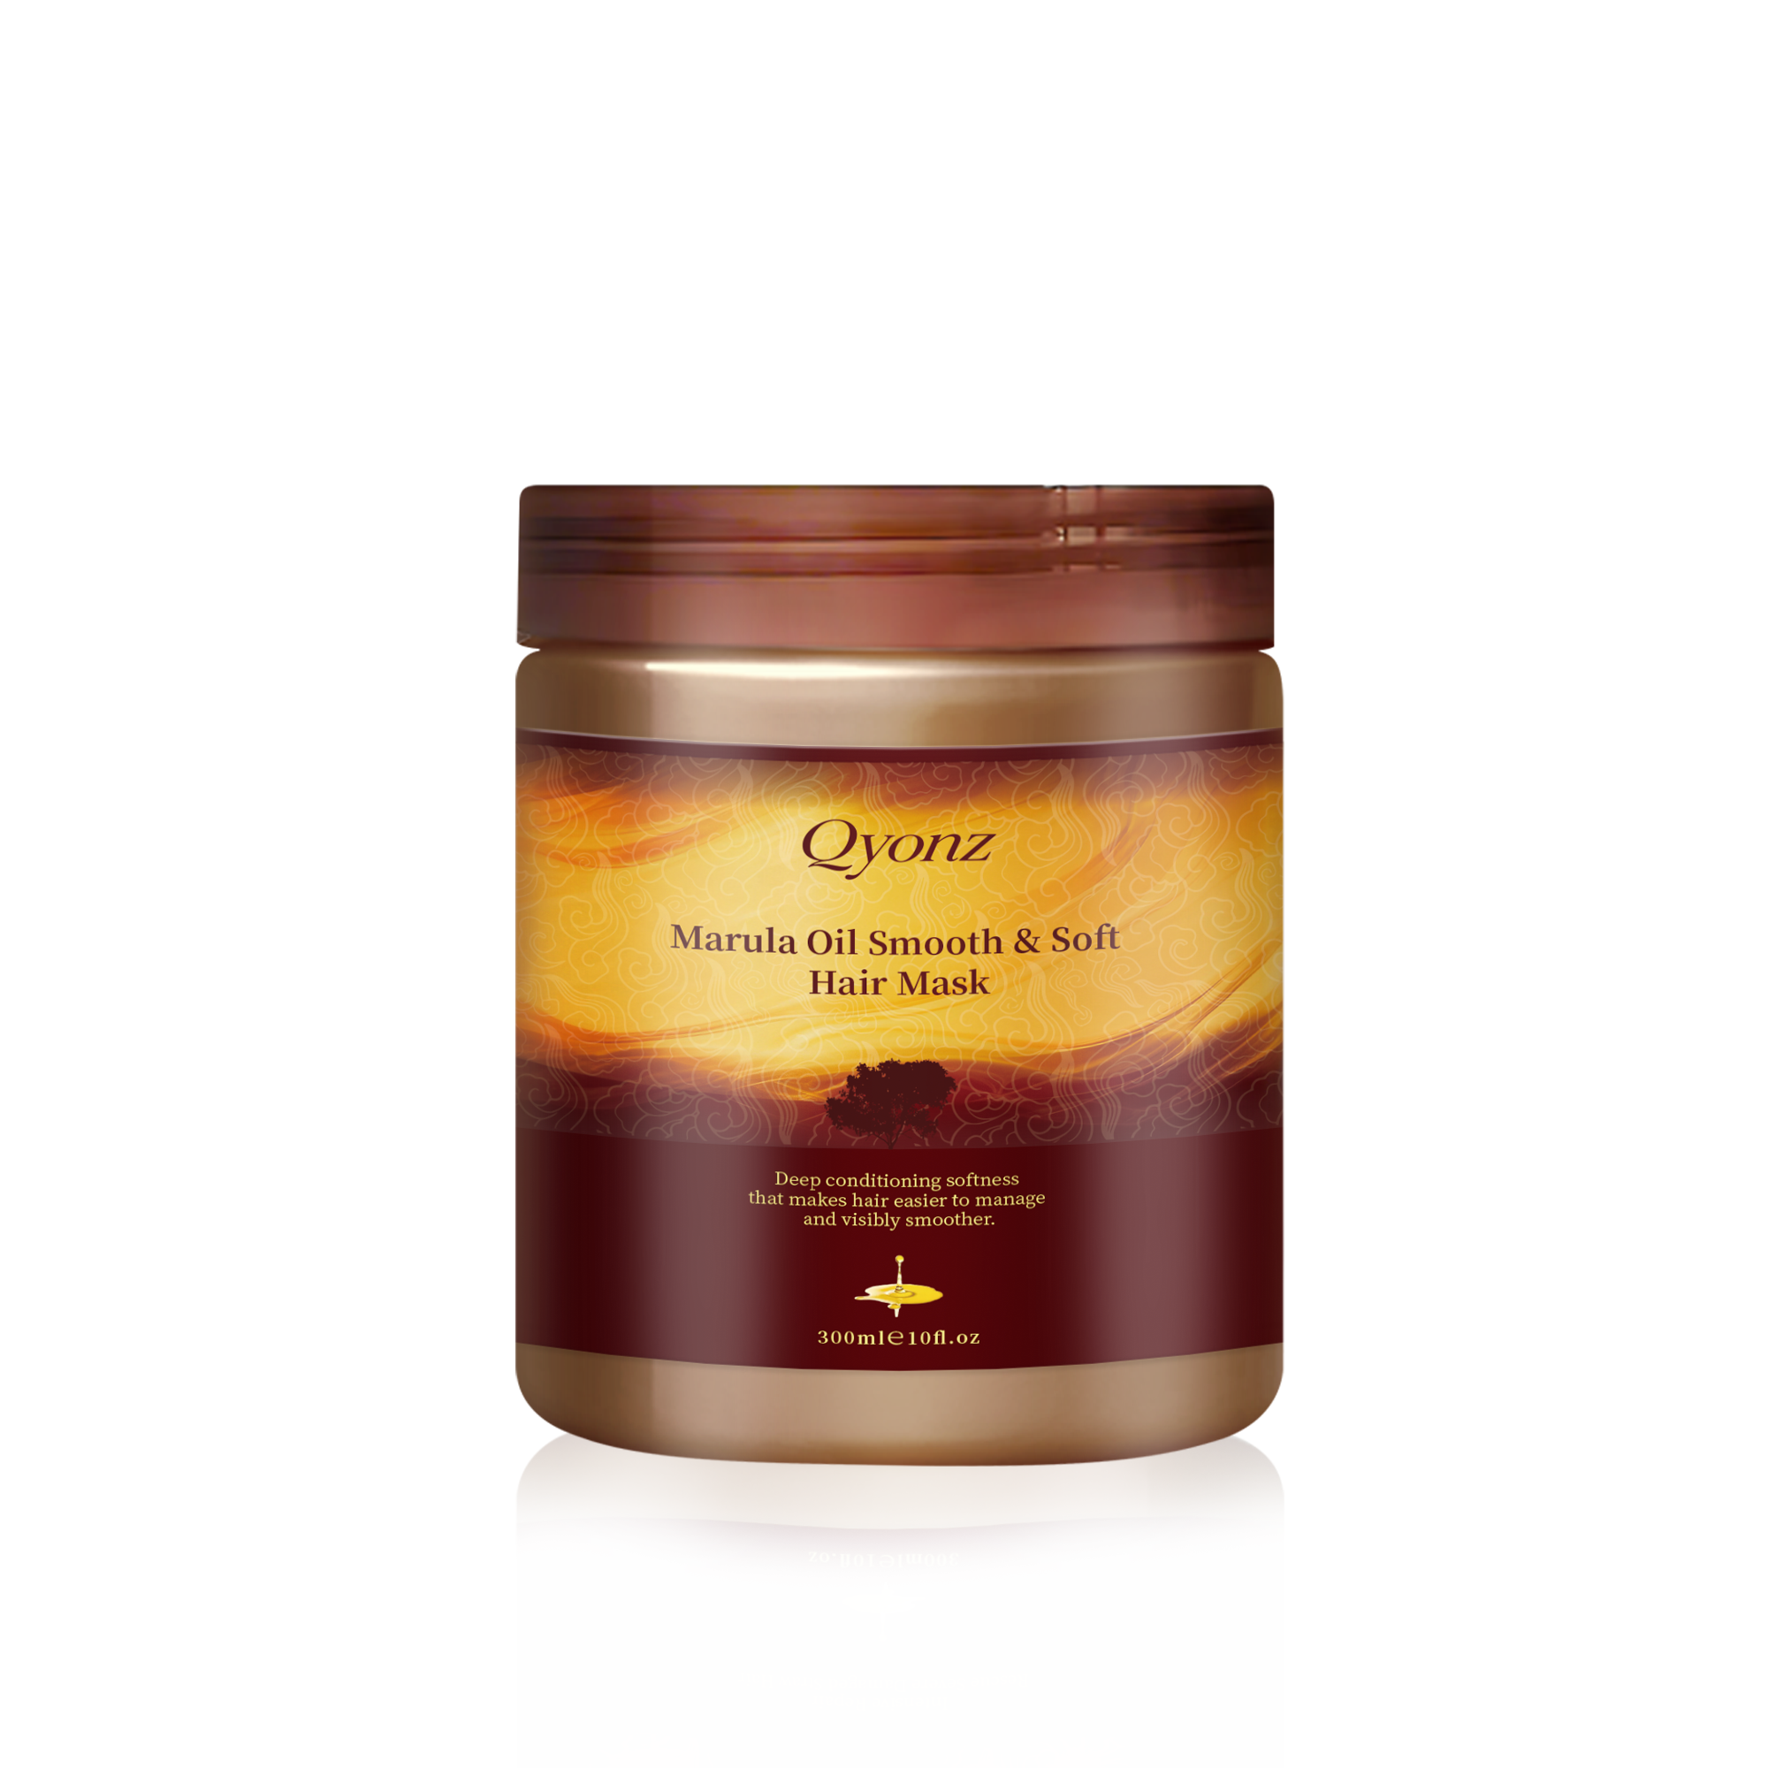
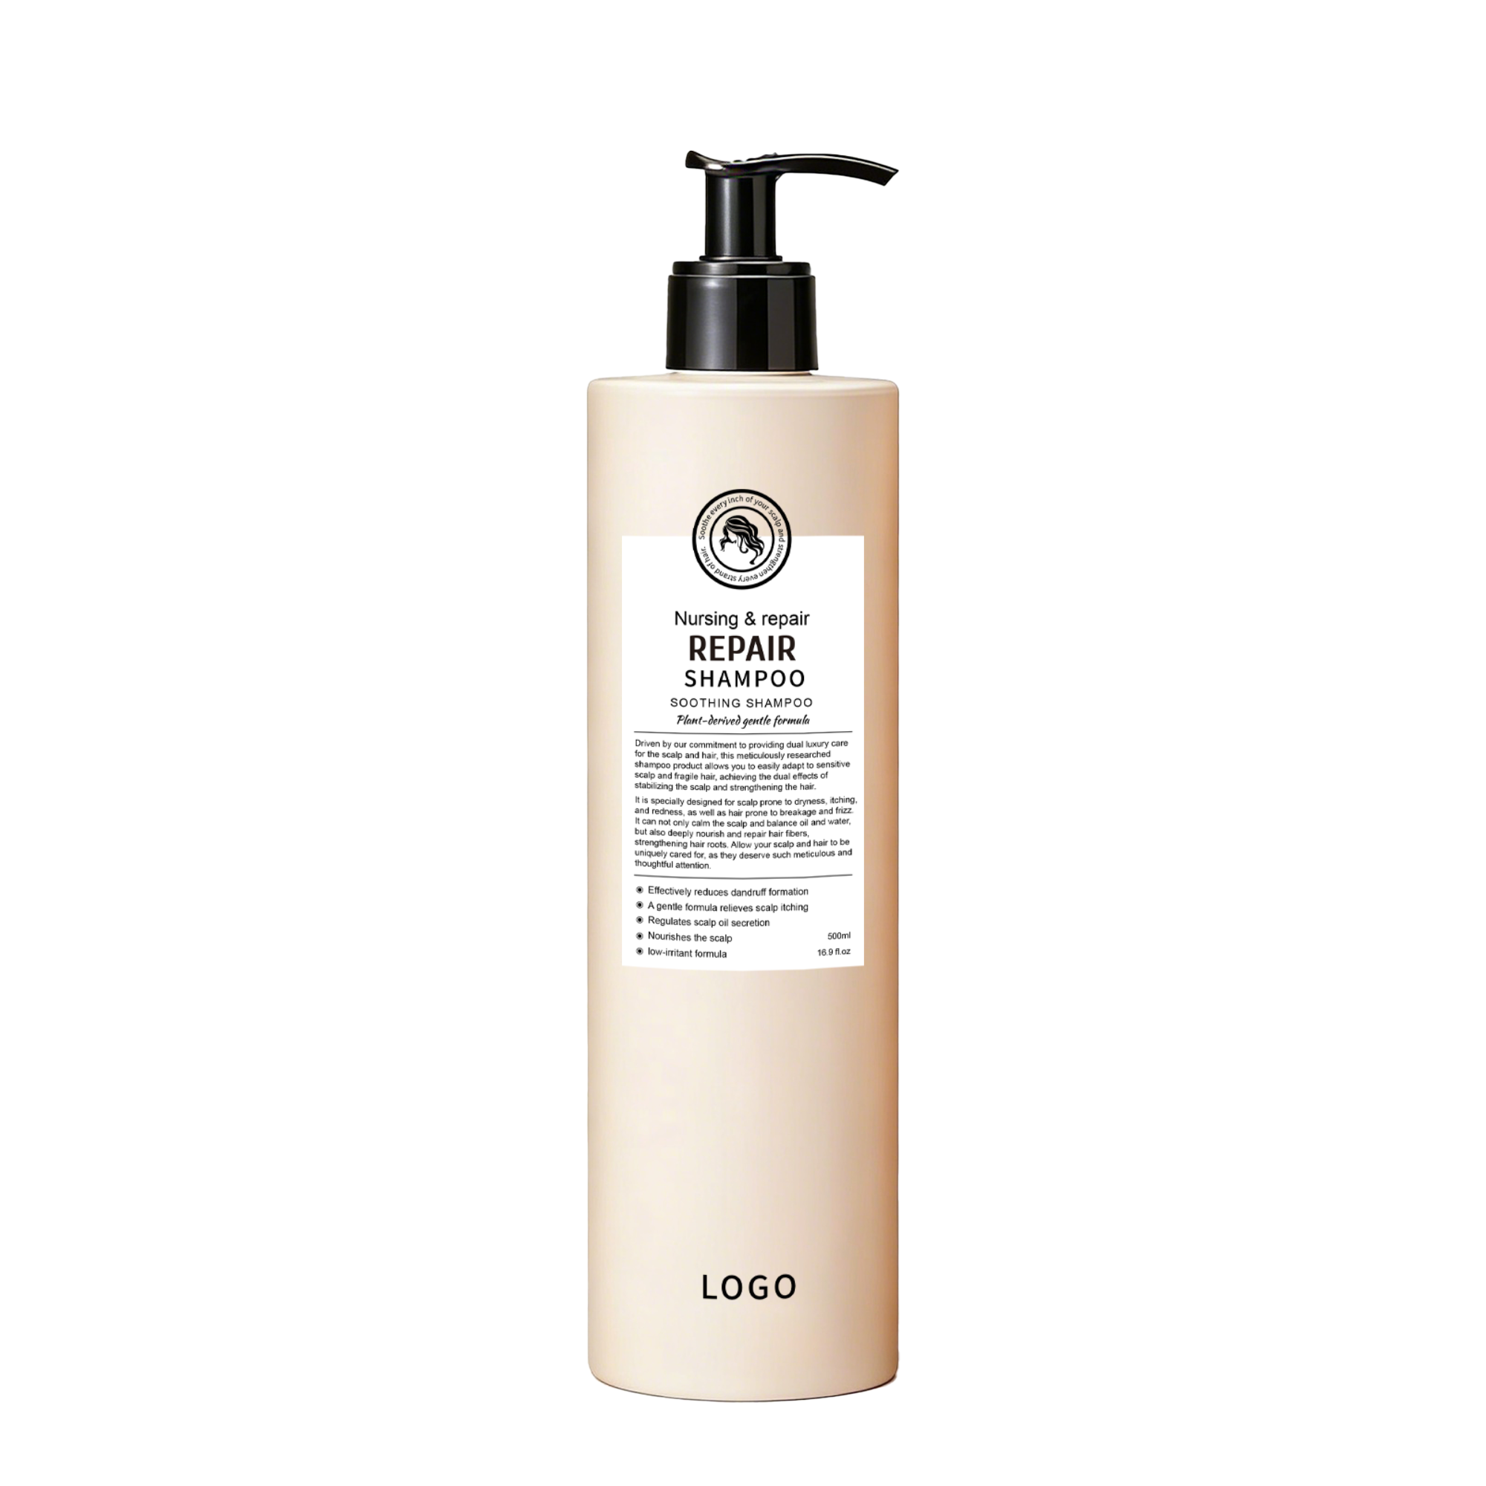
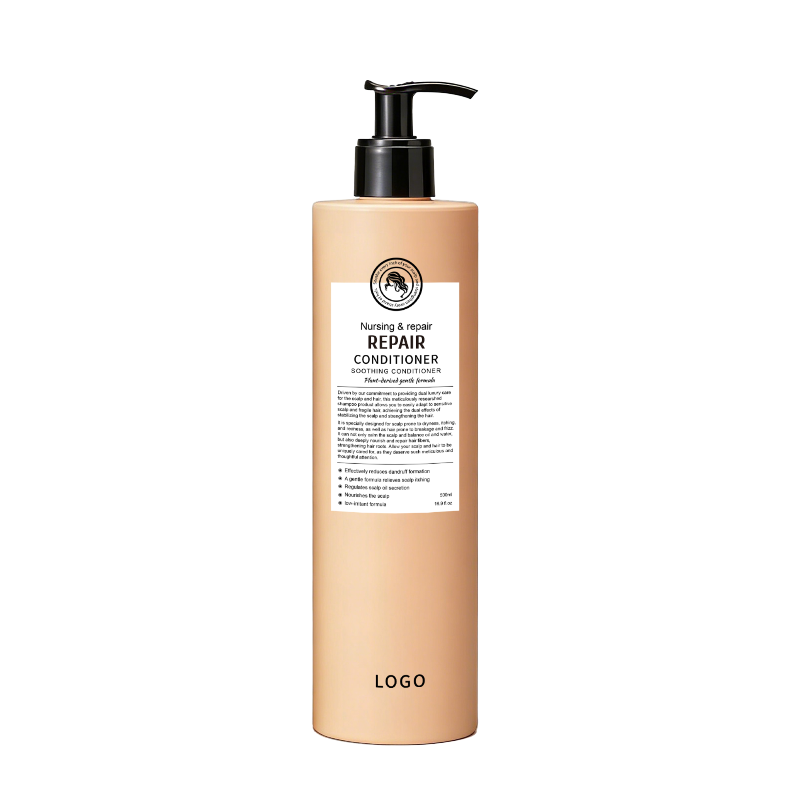
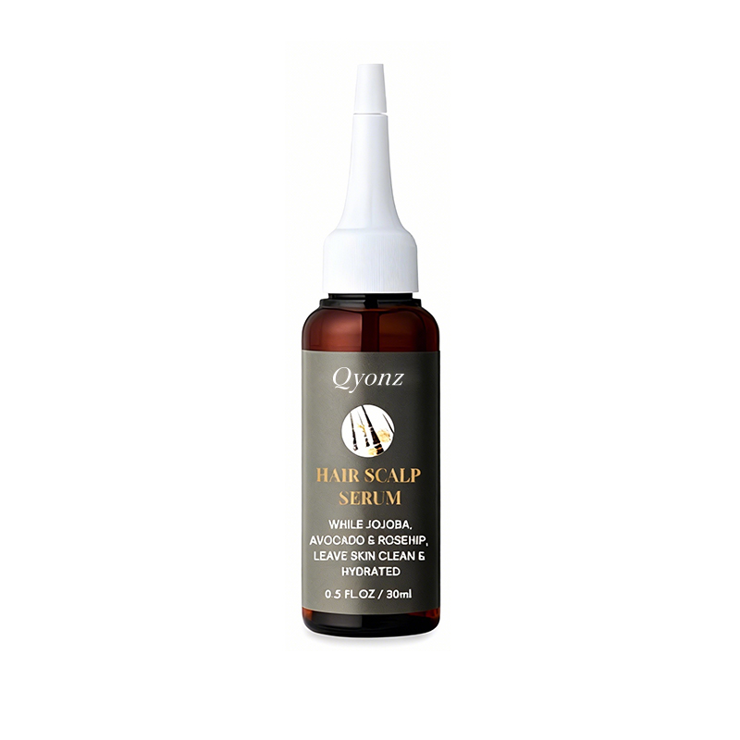
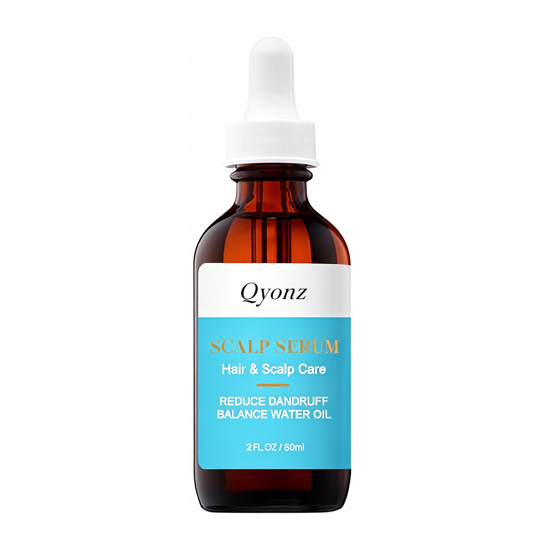
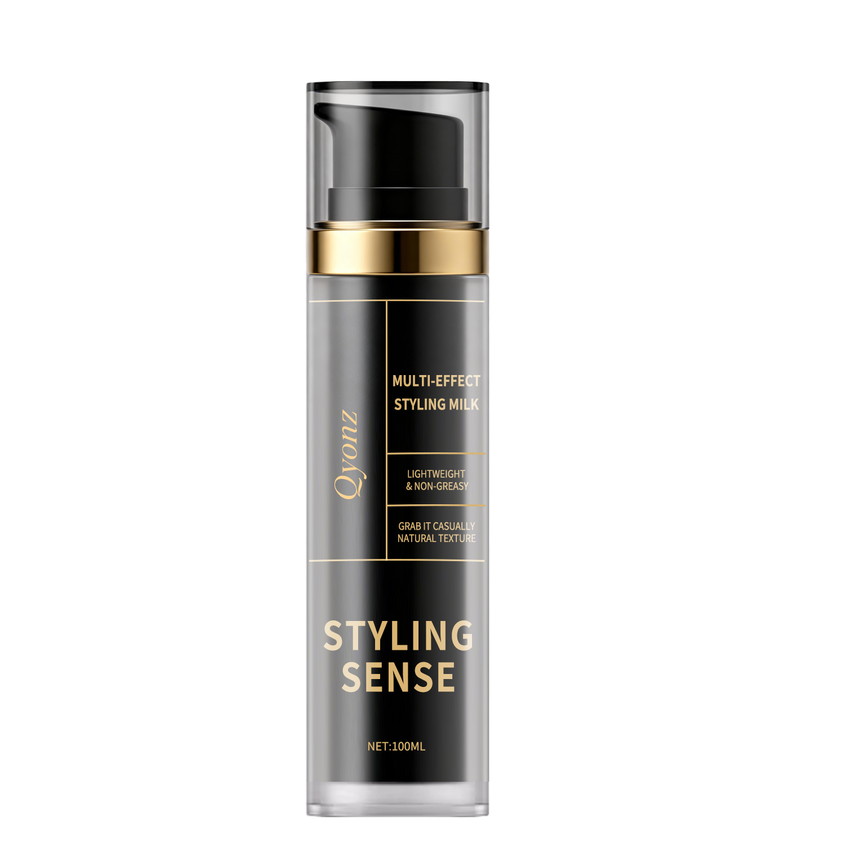
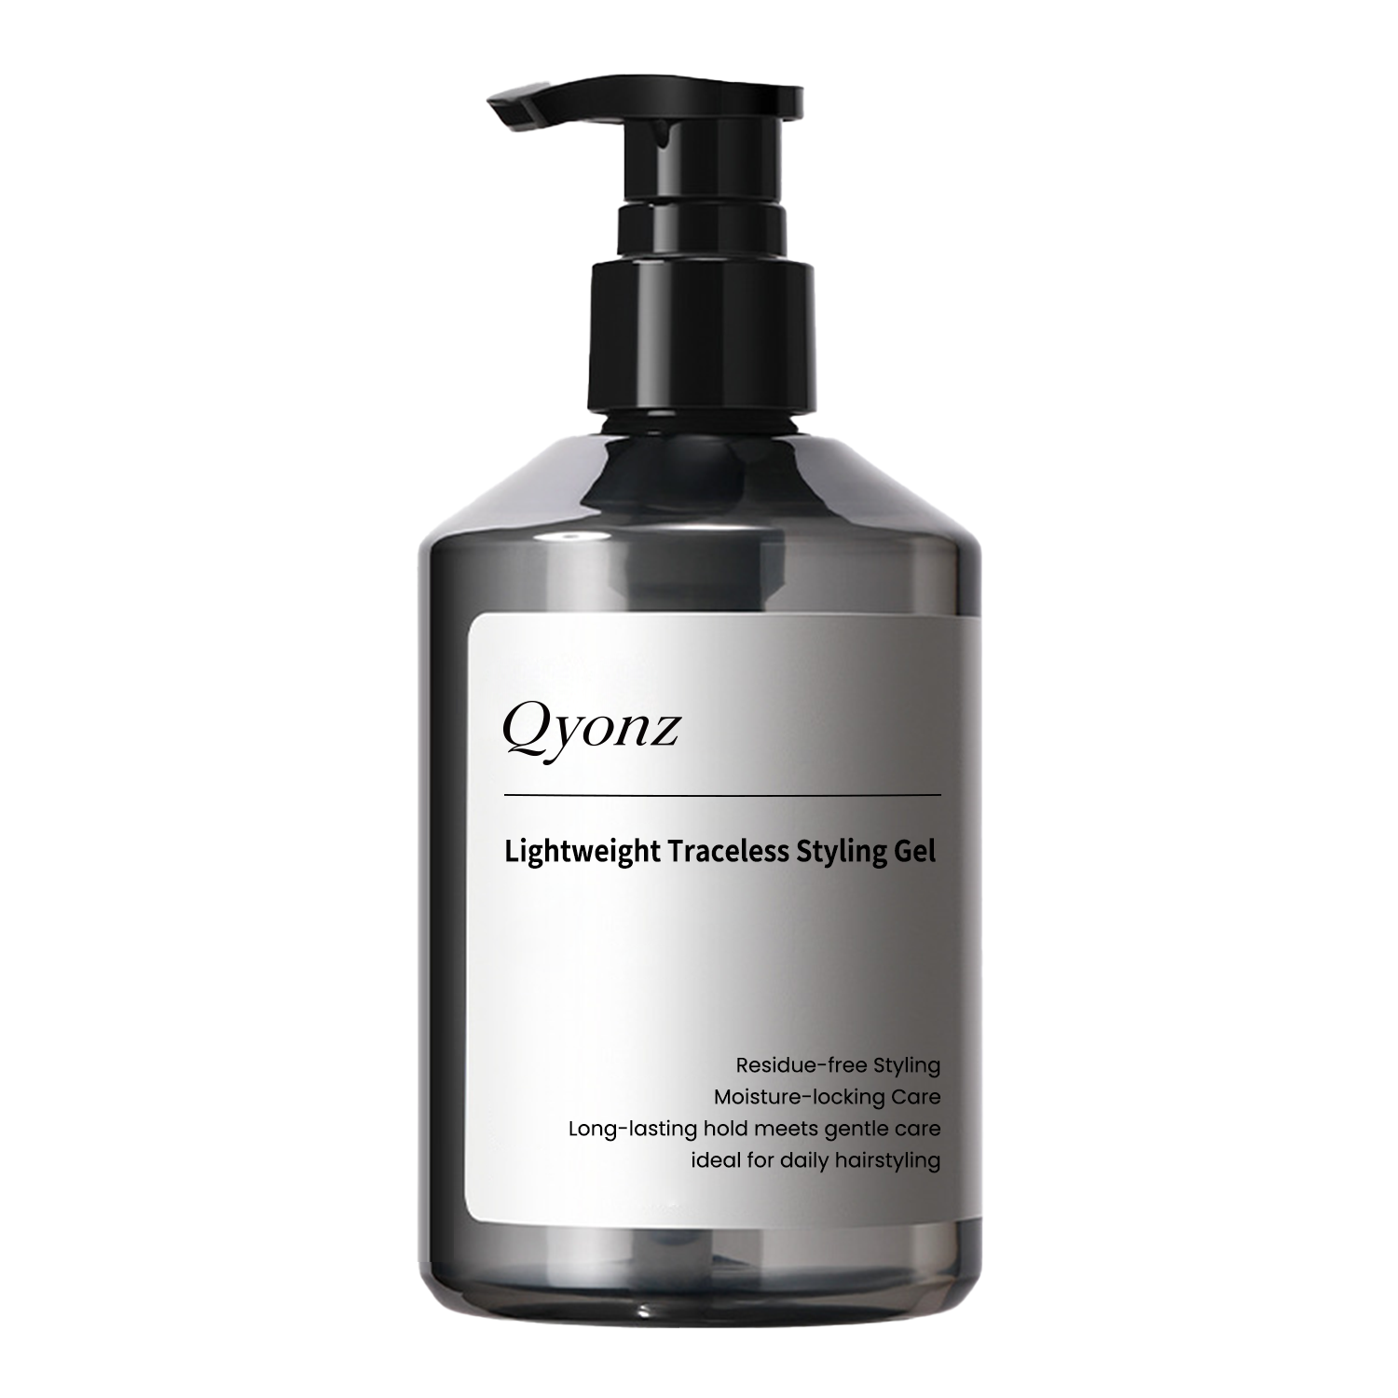
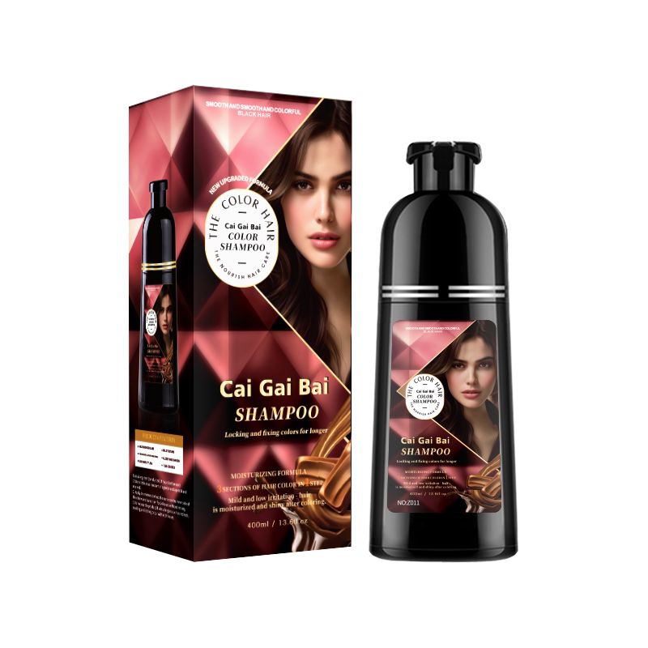
QYONZ
PRODUCT PORTFOLIO B
Additional product visuals to strengthen range perception on the website
10

Slide 11
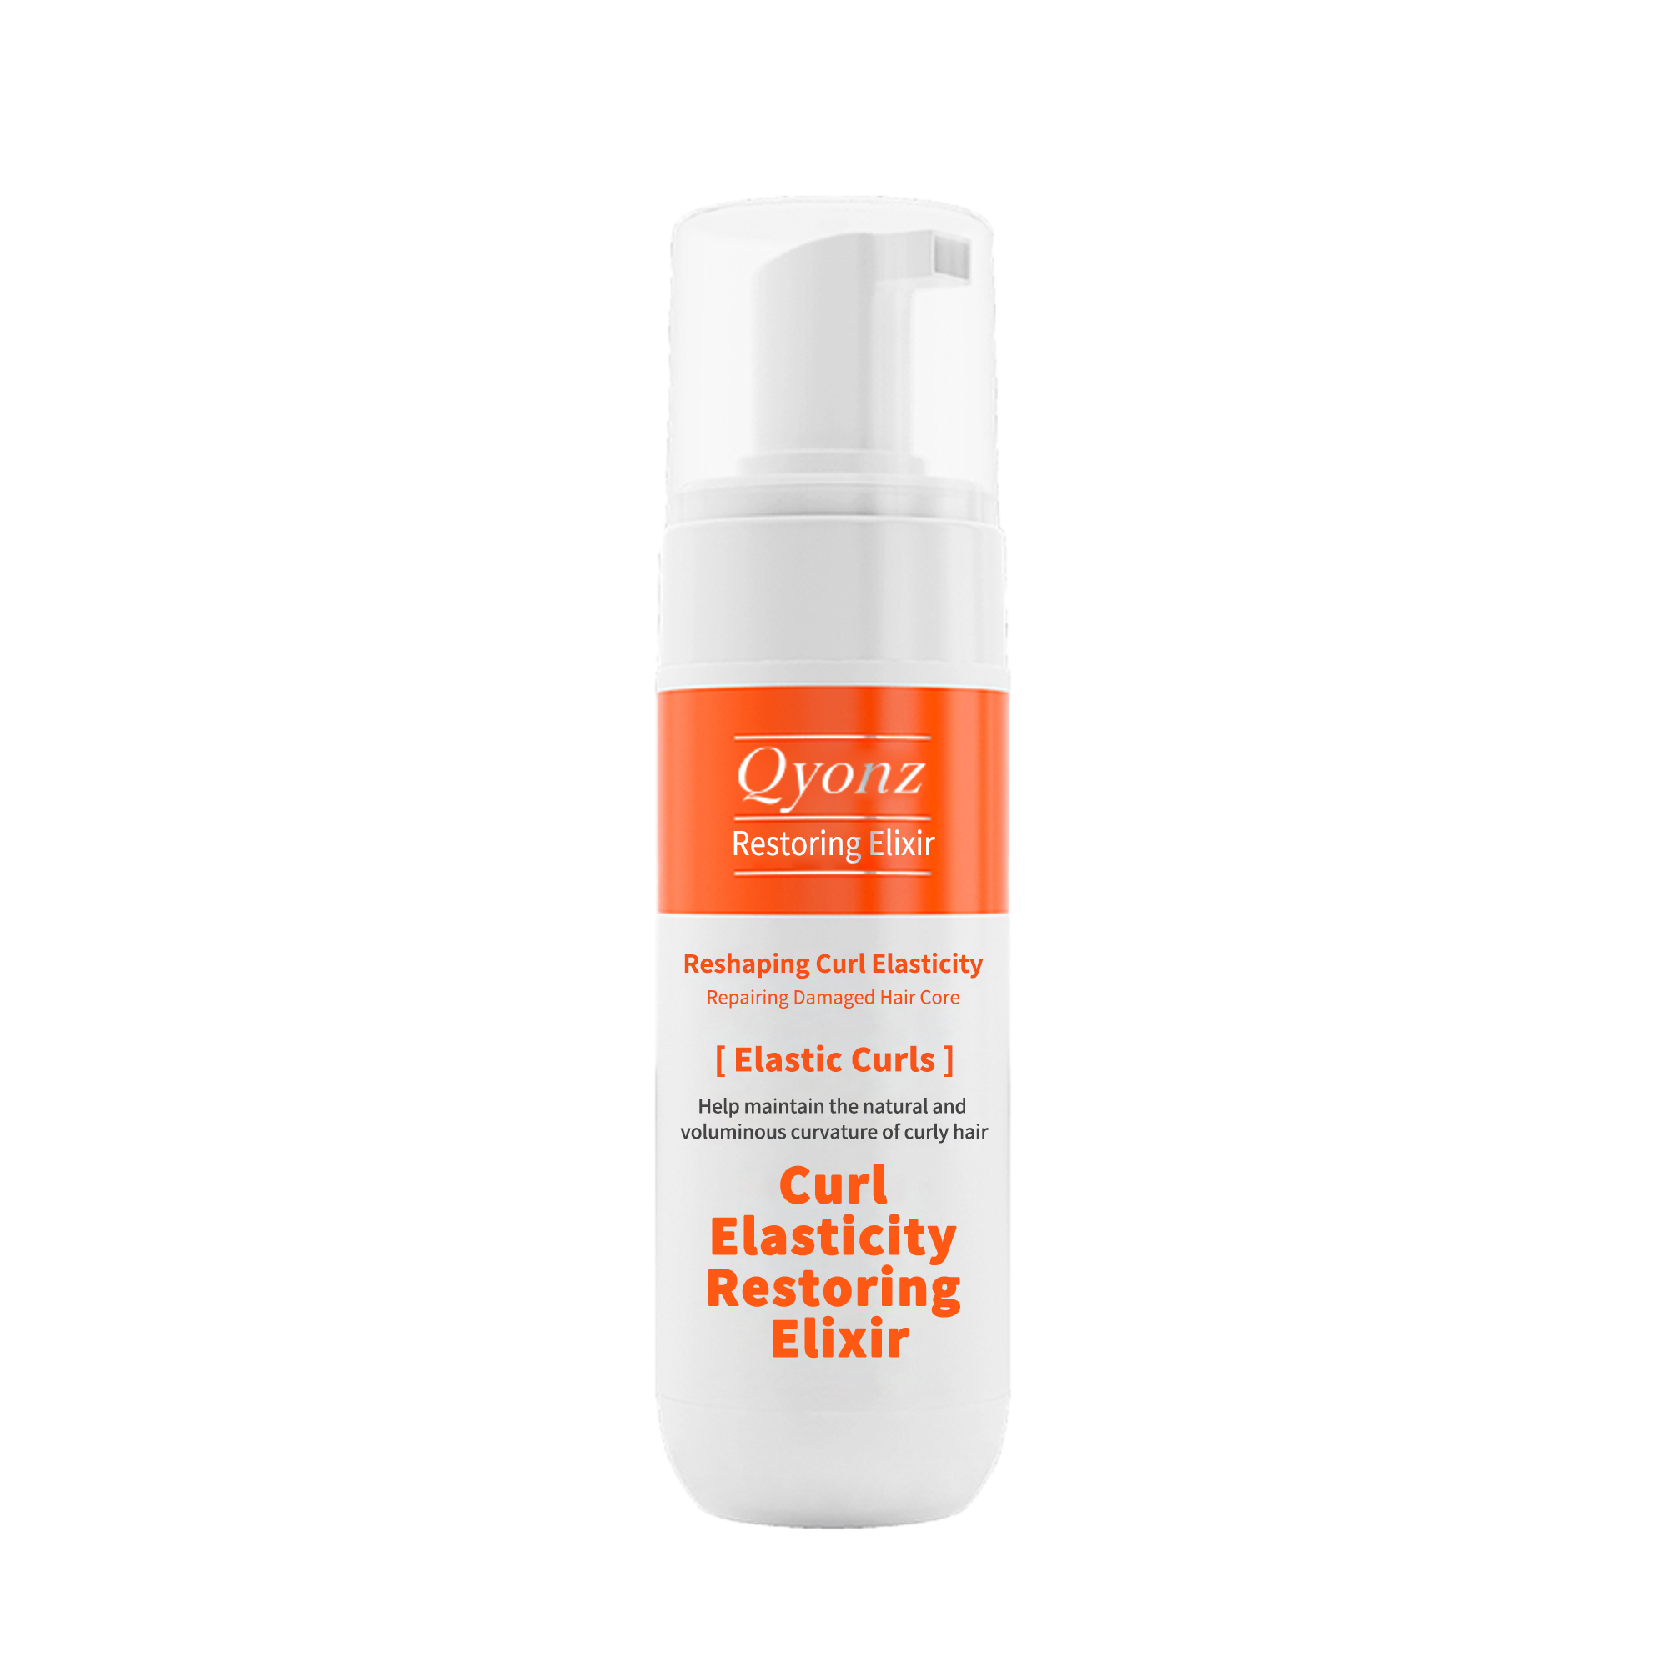
QYONZ
PACKAGING AND CUSTOMIZATION
Formula, packaging and labeling can be discussed as one coordinated OEM / ODM workflow
CUSTOMIZATION STRUCTURE
• Existing packaging options for faster project launch.
• Bottle, pump, cap, box and label coordination by project direction.
• Suitable for single-SKU launch, mixed orders and category bundle planning.
• Basic market-facing text and packaging alignment can be discussed together.
• Useful for brands that want one manufacturing contact point instead of fragmented suppliers.
WEBSITE COPY IDEA
We support formula, packaging, labeling and production execution as one coordinated OEM / ODM workflow.
11

Slide 12
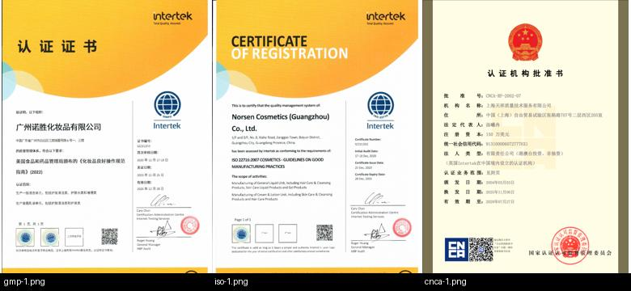
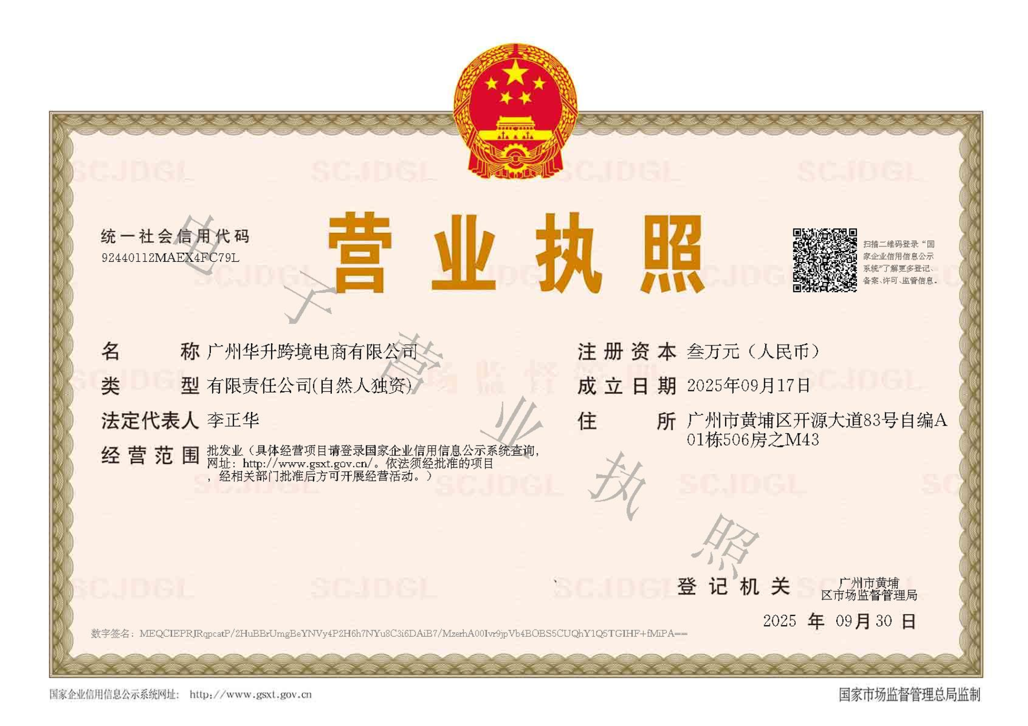
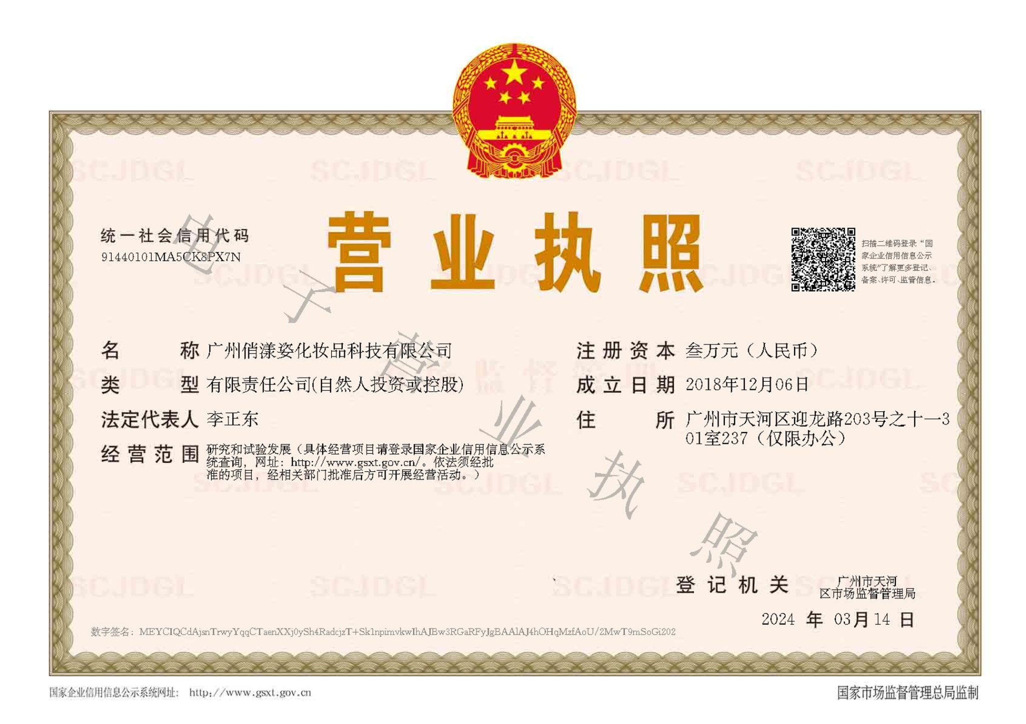
QYONZ
DOCUMENTATION AND GLOBAL MARKET SUPPORT
Presented professionally, this becomes a key trust signal for international buyers
PROJECT-SUPPORTING DOCUMENTS
• MSDS / SDS / COA and product file support.
• FDA / NDC, CPNP / SCPN and market-specific project coordination.
• CPSR, label text preparation and platform-facing documentation support.
• Support scope can be matched by product type, target country and project requirement.
• Documentation is handled as part of project execution rather than as an isolated afterthought.
IMPORTANT POSITIONING
For website language, present documentation support as matched to product category, market and project scope.
12
Notes:
[Sources] /mnt/data/user-38XinLGlPWhCm0hejXQhHCux/4ab182dcd5314e37a6d6044fbb13d01f/mnt/data/certs_montage.jpg /mnt/data/广州华升跨境电商有限公司.png /mnt/data/俏漾姿最新营业执照.png

Slide 13
QYONZ
OEM / ODM WORKFLOW
A clearer process helps buyers feel safer about moving to the next step
1
2
3
4
5
6
7
BRIEF
QUOTE
SAMPLE
CONFIRM
PACKAGING
PRODUCTION
SHIPMENT
MARKET, CATEGORY, PACKAGING AND TARGET PRICE
DIRECTION, PROPOSAL AND COMMERCIAL DISCUSSION
USUALLY 3–7 WORKING DAYS WITH ADJUSTMENT
COMMERCIAL TERMS, DETAILS AND PAYMENT STAGE
LABEL, BOX, BOTTLE AND FINAL SPEC LOCK
SCHEDULED EXECUTION WITH QC CONTROL
DISPATCH, FILE HANDOVER AND REORDER FOLLOW-UP
WHEN THE WORKFLOW IS EASY TO UNDERSTAND, BUYERS FEEL MORE CONFIDENT ABOUT SAMPLING, MOQ, TIMELINE AND DOCUMENT PREPARATION.
13

Slide 14
QYONZ
WHY BRANDS WORK WITH QYONZ
Directly answering the decision points buyers care about most
01
02
03
LOWER MOQ FLEXIBILITY
FACTORY COORDINATION
CATEGORY RANGE
GOOD FOR MARKET TESTING, MIXED ORDERS AND EARLY-STAGE BRAND PROJECTS
R&D, PACKAGING, PRODUCTION AND DOCUMENTS CAN MOVE IN ONE DIRECTION
HAIRCARE, SKINCARE, HAIR COLOR, FRAGRANCE AND BODY CARE CAN RUN IN PARALLEL
04
05
06
DOCUMENT SUPPORT
STEADY DELIVERY RHYTHM
B2B COMMUNICATION READY
MATCHED TO PRODUCT TYPE, TARGET COUNTRY AND PROJECT SCOPE
USEFUL FOR BRANDS WITH CONTENT, CAMPAIGN OR LAUNCH TIMELINES
SUITABLE FOR WEBSITE PDFS, SALES DECKS, SAMPLE OFFERS AND PROJECT DISCUSSIONS
A WEBSITE PROFILE SHOULD HELP THE READER REACH ONE SIMPLE CONCLUSION: THIS IS A FACTORY WORTH CONTINUING THE CONVERSATION WITH.
14

Slide 15
QYONZ
LET US CONTINUE THE DISCUSSION FOR OEM / ODM, PRIVATE LABEL OR CUSTOM MANUFACTURING PROJECTS.
CONTACT
CONTACT
LIAM MAISON
EMAIL
SUPPORT@QYONZ.COM
WHATSAPP
+84 865820315
WEBSITE
HTTPS://QYONZ.COM
RESPONSE
USUALLY WITHIN 12–24 BUSINESS HOURS
QYONZ · OEM / ODM · BEAUTY MANUFACTURING PARTNER
Notes:
[Sources] /mnt/data/生产线1.JPG

